Slide 1
Global E-business and Collaboration
Chapter 2
VIDEO CASES
  Case 1: Walmart’s Retail Link Supply Chain
  Case 2: Salesforce.com: The Emerging Social Enterprise
  Case 3: How FedEx Works: Inside the Memphis Hub
  Instructional Video 1: US Foodservice Grows Market with Oracle CRM on Demand

Slide 2
Learning Objectives
Define and describe business processes and their relationship to information systems.
Evaluate the role played by systems serving the various levels of management in a business and their relationship to each other.
Explain how enterprise applications improve organizational performance.
Notes:
This chapter is designed to provide students a quick overview of the kinds of systems found in a typical corporation. Some of the concepts were introduced in Chapter 1. You could ask students to recall and describe the different levels of management in a business, intranets, and business processes using information from the previous chapter. Some are new—such as enterprise wide systems.

Slide 3
Learning Objectives (cont.)
Explain the importance of collaboration and teamwork in business and how they are supported by technology.
Assess the role of the information systems function in a business.
Notes:
This is a good time to get students to talk about their experience working in organizations. How is collaboration and teamwork important in their business experience? Or the lack of team work? What kinds of work experiences do your students have? What did they think were the key organizational goals where they worked? How were information systems important (or not important)?

Slide 4
TELUS Embraces Social Learning
Problem: Need to capture employee knowledge as 40% of workforce nears retirement
Solutions: New technology for collaborative knowledge sharing
Microsoft SharePoint Server 3010 provided companywide platform for collaboration, knowledge acquisition and transfer, and social tools
Demonstrates IT’s role in collaboration and documenting knowledge
Illustrates the need for changing organizational culture and business processes to use information systems effectively

Slide 5
Business Processes and Information Systems
Business processes:
  Flows of material, information, knowledge
  Sets of activities, steps
  May be tied to functional area or be cross-functional
Businesses: Can be seen as collection of business processes
Business processes may be assets or liabilities
Notes:
Business processes are at the heart of every business. Ask students if they can give any examples of business processes that they come in contact with everyday. This could include anything from ordering a hamburger at McDonalds, to applying for a driver’s license at the DMV. Emphasize that studying a firm’s business processes is an excellent way to learn a great deal about how that business actually works. How could a business process be a liability? Think of some dysfunctional business processes or ask the students to come up with some really poor business process.

Slide 6
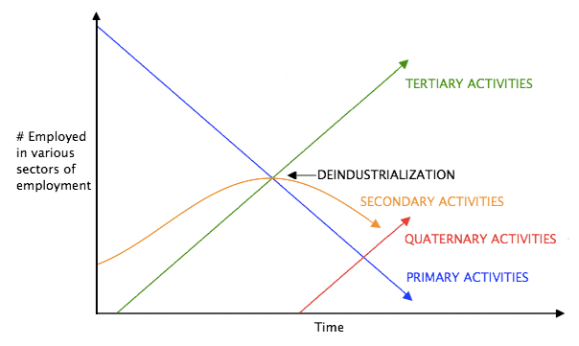

Slide 8
Characterising the knowledge economy
Advances in scientific and technical knowledge enable an ICT revolution, plus the engineering of materials at the molecular level, and new life forms via biotechnology.
Rapid reduction in transportation and telecommunications costs
Integration of previously disparate economies via ICts, trade etc.
Digitization and informatization reduce transaction costs and increase productivity.
Development of a service-based economy, pervasive activities needing intellectual content
Increased emphasis on HE and life-long learning to use the rapidly expanding knowledge base.
Massive investments in R & D, training, education, software, branding, marketing, logistics, and similar services.
Intensified competition between enterprises and nations via new product design, marketing methods, and organizational forms.
Continual restructuring of economies to cope with constant change.

Slide 9

Knowledge workers- who are they?
Would you recognise one if you saw one?
Knowledge workers work in specific sectors/ knowledge workers have particular capabilities, e.g., a knowledge worker has the capacity to
  act autonomously and reflectively
  to use tools effectively and interactively
  to join and function in socially heterogeneous groups (OECD, 2003)

Slide 10
How does intellect relate to knowledge economy issues?
What is intellect?
  Higher education, connectedness, reflexivity, opportunity recognition, knowledge
Knowledge v information
  Tacit v explicit (Nonaka and Taguechi)
  Contexts in knowledge, collective v individualistic
Intangible assets
  Patents,
  trademarks,
  recorded and unrecorded design

Slide 11
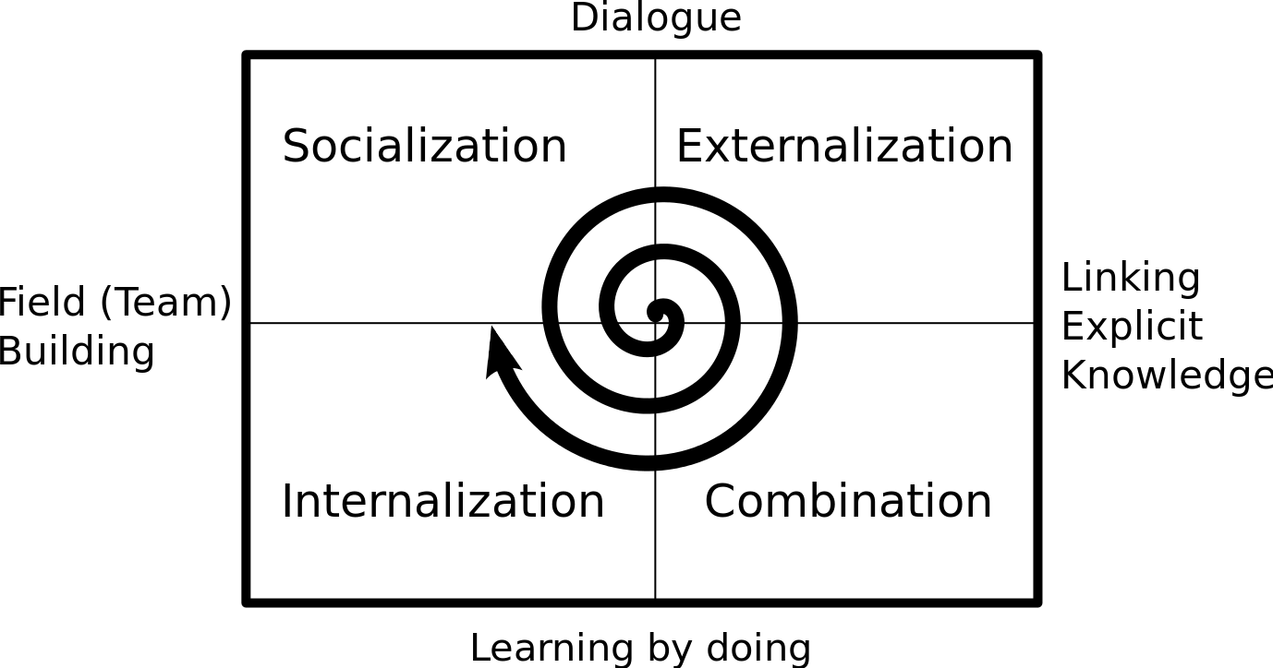

Slide 12
Valuing intellectual assets
Statutes and regs
  WTO, WIPO etc
  IAS ref IAs 38
Valuing a knowledge worker
  Knowledge
  Context and competition
International contrasts
  India and China
  US, Nordic, Japan

Slide 13
Business Processes and Information Systems
Examples of functional business processes
  Manufacturing and production
    Assembling the product
  Sales and marketing
    Identifying customers
  Finance and accounting
    Creating financial statements
  Human resources
    Hiring employees
Notes:
Other examples include checking the product for quality (manufacturing and production), selling the product (sales and marketing), paying creditors (finance and accounting), and evaluating job performance (human resources). You could ask students to contribute other examples of business processes and describe which of the four types they are.

Slide 14
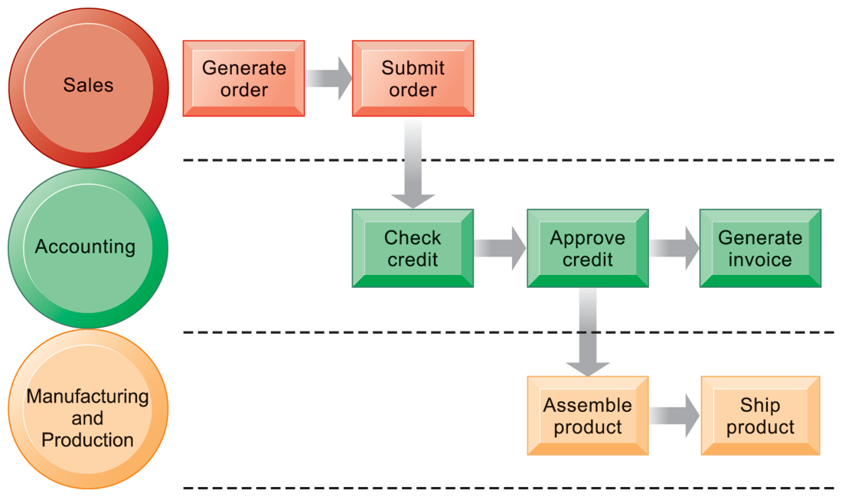
The Order Fulfillment Process
FIGURE 2-1
Fulfilling a customer order involves a complex set of steps that requires the close coordination of the sales, accounting, and manufacturing functions.
Notes:
Emphasize that each rectangle represents one part of the larger business process of order fulfillment. Notice that this business process spans several different functional areas of the business from sales (orders), to accounting, and to manufacturing. Important business processes typically span several different functional areas or divisions in a business.

Slide 15
Business Processes and Information Systems
Information technology enhances business processes by:
  Increasing efficiency of existing processes
    Automating steps that were manual
  Enabling entirely new processes
    Change flow of information
    Replace sequential steps with parallel steps
    Eliminate delays in decision making
    Support new business models
Notes:
Examples of entirely new business processes made possible by information technology are downloading a song from iTunes or buying a book or e-book from Amazon. You might also mention the Amazon book reader Kindle which is continuously connected to the Internet and allows customers to download books and pay for them using Amazon’s one-click purchase method. Ask students if they can name any other business processes that have been transformed in the last year years.

Slide 16
Types of Information Systems
Transaction processing systems
  Serve operational managers and staff
  Perform and record daily routine transactions necessary to conduct business
    Examples: sales order entry, payroll, shipping
  Allow managers to monitor status of operations and relations with external environment
  Serve predefined, structured goals and decision making
Notes:
The purpose of these systems is to answer routine questions about the flow of transactions through the organization. These systems are a necessity for any business.

Slide 17
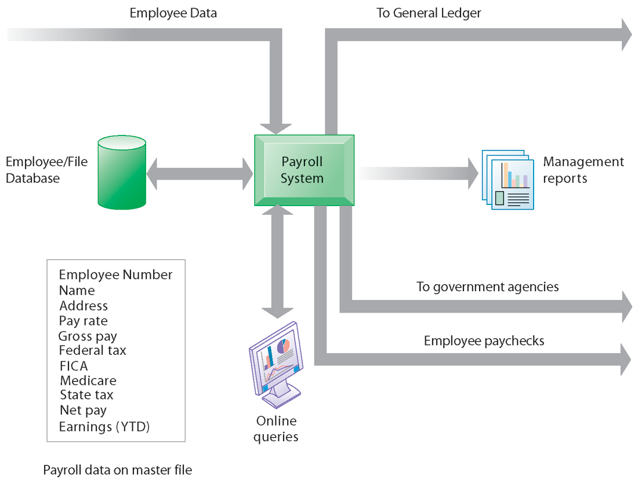
A Payroll TPS
A TPS for payroll processing captures employee payment transaction data (such as a time card). System outputs include online and hard-copy reports for management and employee paychecks.
FIGURE 2-2
Notes:
Note that the outputs of the payroll system are useful not only within the company to managers, but also to regulatory agencies and other entities relying on the accuracy of the reported data.

Slide 18
Types of Information Systems
Business intelligence
  Data and software tools for organizing and analyzing data
  Used to help managers and users make improved decisions
Business intelligence systems
  Management information systems
  Decision support systems
  Executive support systems
Notes:
This slide emphasizes the relationship between the class of software called “business intelligence” and the decision-support systems used by middle and senior management, DSS and ESS. Business intelligence is a type of software used in analyzing data.

Slide 19
CAN AIRLINES SOLVE THEIR BAGGAGE HANDLING PROBLEMS?
What types of transactions are handled by baggage handling systems?
What are the management, organization, and technology components of baggage handling systems?
What is the problem these baggage handling systems are trying to solve? Discuss the business impact of this problem. Are today’s baggage handling systems a solution to this problem?
What kinds of management reports can be generated from the data from these systems?

Slide 20
Types of Information Systems
Management information systems
  Serve middle management
  Provide reports on firm’s current performance, based on data from TPS
  Provide answers to routine questions with predefined procedure for answering them
  Typically have little analytic capability
Notes:
Emphasize to students that management information systems is a specific category of information systems for middle management. It has the same name, but a very different meaning from the term introduced in Chapter 1 (the study of information systems in business and management). In other words, the study of management information systems involves looking at all the systems used in business. An MIS system is a specific type of an IS. It’s easy to get the two confused.

Slide 21
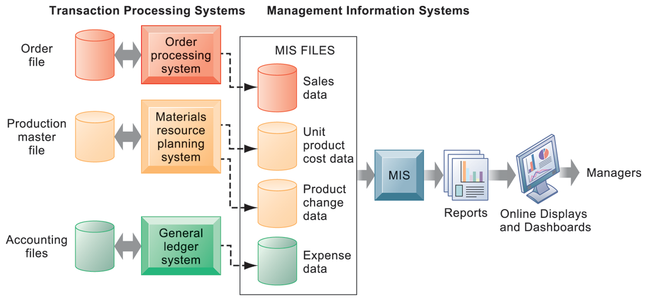
How MIS Obtain Their Data from the Organization’s TPS
FIGURE 2-3
In the system illustrated by this diagram, three TPS supply summarized transaction data to the MIS reporting system at the end of the time period. Managers gain access to the organizational data through the MIS, which provides them with the appropriate reports.
Notes:
Emphasize the relationship between TPS and MIS here. MIS receive data from an organization’s TPS systems and create outputs that management can use to make strategic decisions.

Slide 22
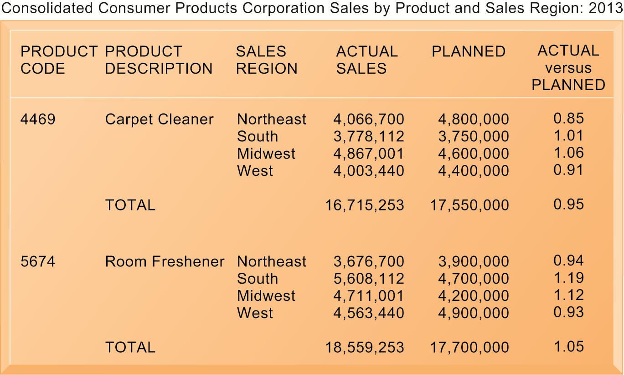
Sample MIS Report
FIGURE 2-4
This report, showing summarized annual sales data, was produced by the MIS in Figure 2-3.
Notes:
This graphic represents the “reports” portion of the Figure 2-3. Emphasize this to students, perhaps referencing that slide again to drive home that point. Students may not understand the decimals in the “ACTUAL versus PLANNED” category, where anything above 1.00 represents more sales than planned and anything less represents a disappointing result of fewer sales than planned.

Slide 23
Dashboard Sample

Slide 24
Knowledge Management
Framework

Slide 25
Data Warehouse: A Multi-Tiered Architecture
Monitor
&
Integrator
OLAP Server
Other
sources
Metadata
Analysis
Query
Reports
Data mining
Operational
DBs
Extract
Transform
Load
Refresh
Data
Warehouse
(Veri Ambarı)
Serve
Data Marts
Veri Kaynakları
Data Storage
OLAP Engine
Front-End Tools

Slide 27
Types of Information Systems
Decision support systems
  Serve middle management
  Support non-routine decision making
    Example: What is the impact on production schedule if December sales doubled?
  May use external information as well TPS / MIS data
  Model driven DSS
    Voyage-estimating systems
  Data driven DSS
    Intrawest’s marketing analysis systems
Notes:
You could ask whether or not students understand what is meant by non-routine decision making, as opposed to routine decision making, and why DSS are specifically designed to assist managers in making that type of decision. Ask students for examples of non-routine decisions they make or have made in the past as managers or employees.

Slide 28
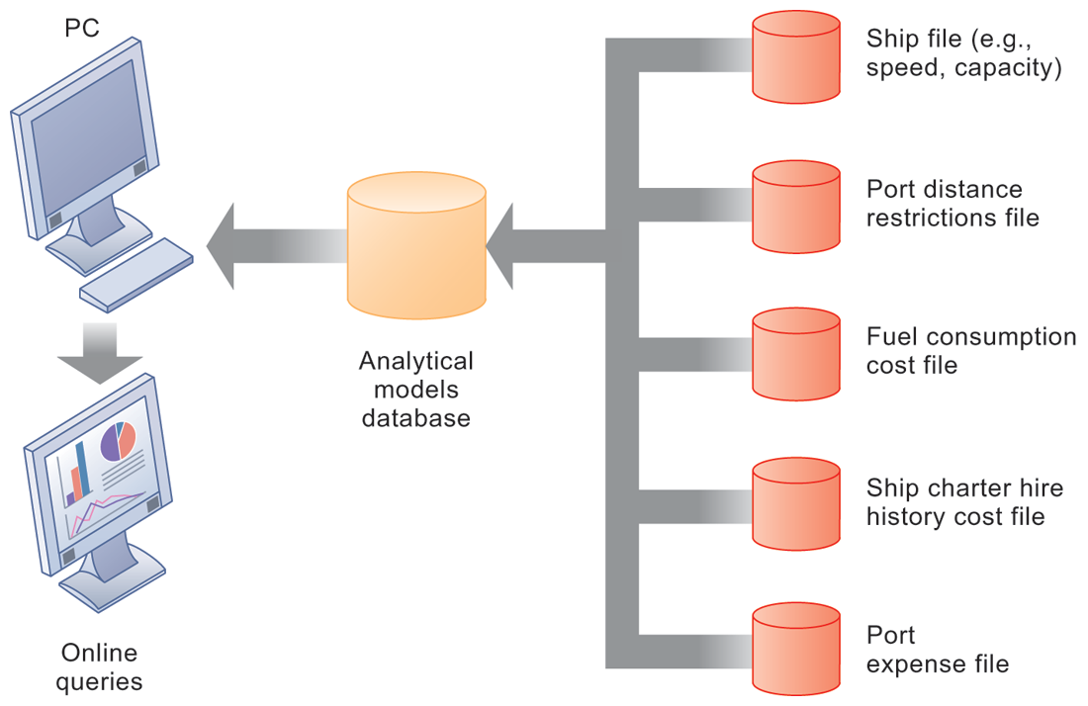
Voyage-Estimating Decision Support System
FIGURE 2-5
This DSS operates on a powerful PC. It is used daily by managers who must develop bids on shipping contracts.
Notes:
DSS can rely on either analytical models or large databases to provide valuable information. You could ask which of these two types the above figure best resembles (analytical models). You could also ask them what types of decisions does this system help its users make? Examples include what vessels to send to particular destinations to maximize profit, the optimal loading pattern for cargo, and the optimal rate at which vessels should travel to maximize efficiency while still meeting their schedules, and so forth.

Slide 29
Types of Information Systems
Executive support systems
  Support senior management
  Address non-routine decisions
    Requiring judgment, evaluation, and insight
  Incorporate data about external events (e.g. new tax laws or competitors) as well as summarized information from internal MIS and DSS
  Example: Digital dashboard with real-time view of firm’s financial performance: working capital, accounts receivable, accounts payable, cash flow, and inventory
Notes:
Emphasize the connection between ESS, MIS, and DSS. ESS rely on accurate inputs from a firm’s MIS and DSS to provide useful information to executives. These systems should not exist in isolation from one another. If they are isolated from one another, it is a kind of organizational dysfunction, probably inherited from the past. Note that the digital dashboard is a common feature of modern-day ESS. Emphasize that a critical feature of ESS is ease of use and simplicity of display. Executives using an ESS want quick access to the most critical data affecting their firm.

Slide 30
PILOTING PROCTER & GAMBLE FROM DECISION COCKPITS
What management, organization, and technology issues had to be addressed when implementing Business Sufficiency, Business Sphere, and Decision Cockpits?
How did these decision-making tools change the way the company ran its business? How effective are they? Why?
How are these systems related to P&G’s business strategy?

Slide 31
Types of Information Systems
Enterprise applications
  Systems for linking the enterprise
  Span functional areas
  Execute business processes across firm
  Include all levels of management
  Four major applications:
    Enterprise systems
    Supply chain management systems
    Customer relationship management systems
    Knowledge management systems
Notes:
Enterprise applications are used to manage the information used in the systems discussed previously. In other words, enterprise applications are used to ensure that TPS, MIS, DSS, and ESS work together smoothly.

Slide 32
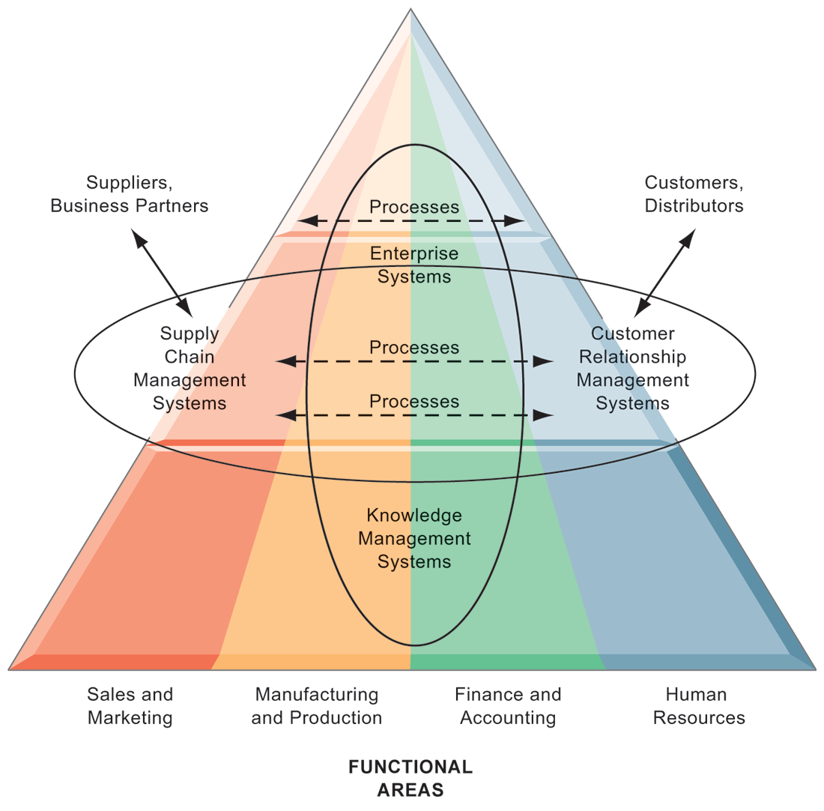
Enterprise Application Architecture
Enterprise applications automate processes that span multiple business functions and organizational levels and may extend outside the organization.
FIGURE 2-6
Notes:
The purpose of this graphic is simply to illustrate that enterprise systems are very large and diverse databases that pull information from many parts of the firm and enable processes both across the firm, at different organizational levels, as well as with suppliers and customers.
The triangle represents the organization, with different colors for the four main business functions. The ovals show that an enterprise application architecture incorporates systems used in sales and marketing, enabling these to communicate with each other and externally, with suppliers and customers. It also incorporates information supplied by knowledge management systems, manufacturing and finance systems, and other enterprise systems. The purpose of incorporating data and information from all of these sources is to enable and automate cross-functional business processes and supply accurate information to aid decision making.

Slide 33
Types of Information Systems
Enterprise systems
  Collects data from different firm functions and stores data in single central data repository
  Resolves problem of fragmented data
  Enable:
    Coordination of daily activities
    Efficient response to customer orders (production, inventory)
    Help managers make decisions about daily operations and longer-term planning
Notes:
This slide emphasizes the singularity of enterprise systems (one system) that integrates information flows from a variety of sources and serves a wide variety of groups and purposes in the firm. Remind students of the difference between enterprise applications and enterprise systems: Enterprise applications are any applications that span the enterprise, and types of enterprise applications include CRM, SCM,KMS and enterprise systems. Enterprise systems refers to the larger database environment within which these applications reside and operate.
Note that enterprise systems are referred to in some first as “enterprise resource planning systems (ERP).

Slide 34
Types of Information Systems
Supply chain management (SCM) systems
  Manage firm’s relationships with suppliers
  Share information about:
    Orders, production, inventory levels, delivery of products and services
  Goal:
    Right amount of products to destination with least amount of time and lowest cost
Notes:
Emphasize that SCM systems are interorganizational systems, automating the flow of information across organizational boundaries. This distinction is important because SCM systems must be designed with the business processes of potential partners and suppliers in mind.

Slide 35
Types of Information Systems
Customer relationship management systems:
  Provide information to coordinate all of the business processes that deal with customers
    Sales
    Marketing
    Customer service
  Helps firms identify, attract, and retain most profitable customers
Notes:
CRM systems are extremely important for both marketing and customer service. You could ask students if they’ve ever filled out a survey for a company. Then connect that to information systems, perhaps explaining that the information they entered was provided as input to a CRM system for analysis.

Slide 36
Types of Information Systems
Knowledge management systems (KMS)
  Support processes for capturing and applying knowledge and expertise
    How to create, produce, deliver products and services
  Collect internal knowledge and experience within firm and make it available to employees
  Link to external sources of knowledge
Notes:
The idea that business firms are repositories of knowledge may be new to many students. Ask students for examples of firm knowledge, for instance, the knowledge required to run a fast food restaurant, or the knowledge required to operate a Web site such as Amazon. Explain that knowledge management systems are useful for helping a firm’s employees understand how to perform certain business processes or how to solve problems. What might the consequences be for a firm with poor knowledge management systems?

Slide 37
Types of Information Systems
Also used to increase integration and expedite the flow of information
  Intranets:
    Internal company Web sites accessible only by employees
  Extranets:
    Company Web sites accessible externally only to vendors and suppliers
    Often used to coordinate supply chain
Notes:
Enterprise applications are typically extremely expensive as well as difficult to implement. Ask students why this would be so:
Intranets and extranets use Internet technology to communicate internally to employees, allow employees to communicate with one another and share documents, and to help communication with vendors. They are essentially password protected Web sites. The simplest intranets and extranets may use static Web pages to relay information, whereas more sophisticated versions may be database-driven and enable key business processes. Ask students if they have used an intranet or extranet before and what services or information it provided. Does their school have an intranet/extranet? Generally universities have a Web site with different levels of access for the general public, registered students, faculty, and administrators. The public-facing part of the Web site can be thought of as the “extranet,” while the part of the Web site serving students and faculty can be thought of as the “intranet.” These terms (intranet and extranet) are fading from use, but students will occasionally find firms still using these terms.

Slide 38
Types of Information Systems
E-business
  Use of digital technology and Internet to drive major business processes
E-commerce
  Subset of e-business
  Buying and selling goods and services through Internet
E-government:
  Using Internet technology to deliver information and services to citizens, employees, and businesses
Notes:
The use of Internet technology has transformed and continues to transform businesses and business activity. This slide aims to distinguish different terminology used in the book.
E-business refers to the use of the Internet and networking to enable all parts of the business, whereas e-commerce refers to just that part of business that involves selling goods and services over the Internet.
Internet technology has also brought similar changes in the public sector—the use of Internet and networking technologies in government is referred to as e-government. Ask students what changes in businesses or government due to new Internet technologies they have noticed.

Slide 39
Systems for Collaboration and Teamwork
Collaboration:
  Short-lived or long-term
  Informal or formal (teams)
Growing importance of collaboration:
  Changing nature of work
  Growth of professional work—“interaction jobs”
  Changing organization of the firm
  Changing scope of the firm
  Emphasis on innovation
  Changing culture of work
Notes:
A number of factors are leading to a growing emphasis on collaboration in the firm. Work is changing, requiring more cooperation and coordination. Professions play a larger role in firms than before, and this often requires more consultation among experts than before. Organizations are flatter, with many more decisions made far down in the hierarchy. Organizations are more far flung around the globe, in multiple locations. There’s an emphasis on finding and sharing ideas which requires collaboration. Finally, what it means to be a “good” employee these days is in part an ability to work with others, and collaborate effectively. The culture of work has changed.

Slide 40
Systems for Collaboration and Teamwork
Social business
  Use of social networking platforms, internal and external
  Engage employees, customers, and suppliers
  Goal is to deepen interactions and expedite information sharing
  “Conversations”
  Requires information transparency
    Driving the exchange of information without intervention from executives or others
Notes:
Ask students how they use social sites such as Facebook, and if they have ever used these sites for business purposes. How about Twitter?

Slide 41
Systems for Collaboration and Teamwork
Business benefits of collaboration and teamwork
  Investments in collaboration technology can bring organization improvements, returning high ROI
  Benefits:
    Productivity
    Quality
    Innovation
    Customer service
    Financial performance
      Profitability, sales, sales growth
Notes:
Research regarding the business benefits of collaboration is anecdotal; however, business and academic communities generally regard collaboration as an essential driving factor in business success: Firms that collaborate more make more money.
Ask students to give examples of how collaboration can improve productivity, product quality, and customer service. Has anyone had a fruitful collaborative experience in which an aspect of a company they worked at or an organization they were in?

Slide 42
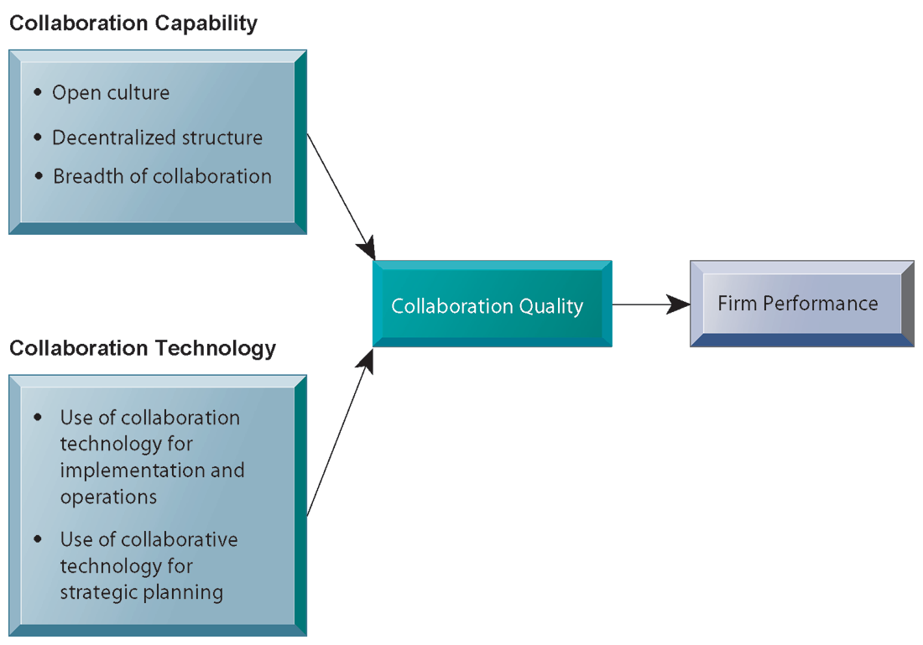
Requirements for Collaboration
Successful collaboration requires an appropriate organizational structure and culture, along with appropriate collaboration technology.
FIGURE 2-7
Notes:
This slide graphically describes how collaboration is believed to impact business performance. Two primary ingredients are needed: collaboration capability (including how much collaboration is possible) and collaboration technology or means. The quality of these two factors directly affects firm performance—the higher quality of collaboration means better firm performance. Ask students how collaboration can be high or low quality? An example of low-quality collaboration could be a team put together to solve a business problem but is unable to effectively work together because of internal politics. Do students have any experience with poor collaboration?

Slide 43
Systems for Collaboration and Teamwork
Building a collaborative culture and business processes
  “Command and control” organizations
    No value placed on teamwork or lower-level participation in decisions
  Collaborative business culture
    Senior managers rely on teams of employees.
    Policies, products, designs, processes, and systems rely on teams.
    The managers purpose is to build teams.
Notes:
Collaboration is not something that spontaneously arises—it must be enabled and nurtured. Collaborative culture is an essential factor—simply having collaborative technology will not result in collaboration if it isn’t seen as part of the business and rewarded. Have any students worked at “command and control” organizations? If so, were they able to see aspects of the business that could be improved but were unable to make contributions because of the firm’s culture? Are there any businesses or business functions that benefit by less collaboration? Are there any disadvantages to collaboration?

Slide 44
Systems for Collaboration and Teamwork
Tools for collaboration and teamwork
  E-mail and instant messaging
  Wikis
  Virtual worlds
  Collaboration and social business platforms
    Virtual meeting systems (telepresence)
    Google Apps/Google sites
    Cyberlockers
    Microsoft SharePoint
    Lotus Notes
    Enterprise social networking tools
Notes:
The text goes into more depth on each of these tools. Give an example for each type of tool. A business use of social networking is Facebook accounts for businesses; using wikis as extended, more complete FAQs, and virtual worlds to conduct online meetings for employees around the world. Distinguish these individual tools from Internet-based collaboration environments, which are suites of collected collaboration tools, enabling communication and data-sharing between tools. How many of your students used Google Docs?

Slide 45
Systems for Collaboration and Teamwork
Enterprise social networking software capabilities
  Profiles
  Content sharing
  Feeds and notifications
  Groups and team workspaces
  Tagging and social bookmarking
  Permissions and privacy

Slide 46
Systems for Collaboration and Teamwork
Two dimensions of collaboration technologies
  Space (or location)—remote or co-located
  Time—synchronous or asynchronous
Six steps in evaluating software tools
  What are your firm’s collaboration challenges?
  What kinds of solutions are available?
  Analyze available products’ cost and benefits.
  Evaluate security risks.
  Consult users for implementation and training issues.
  Evaluate product vendors.
Notes:
When evaluating collaboration tools for your businesses, the first step is to identify the kind of problem you have. The key problems are time and location. Generally, no one has enough time and often key people are not in the right place. Some teams may need to work together in real-time, whereas others may simply need shared documentation. In analyzing collaboration tools by the space/time dimensions you can determine what types of tools will solve your problem. The six steps in evaluating software are applicable not only for collaboration tools but any software solution for your company. First determine the challenge or problem, look for solutions for this particular problem, and so forth.

Slide 47
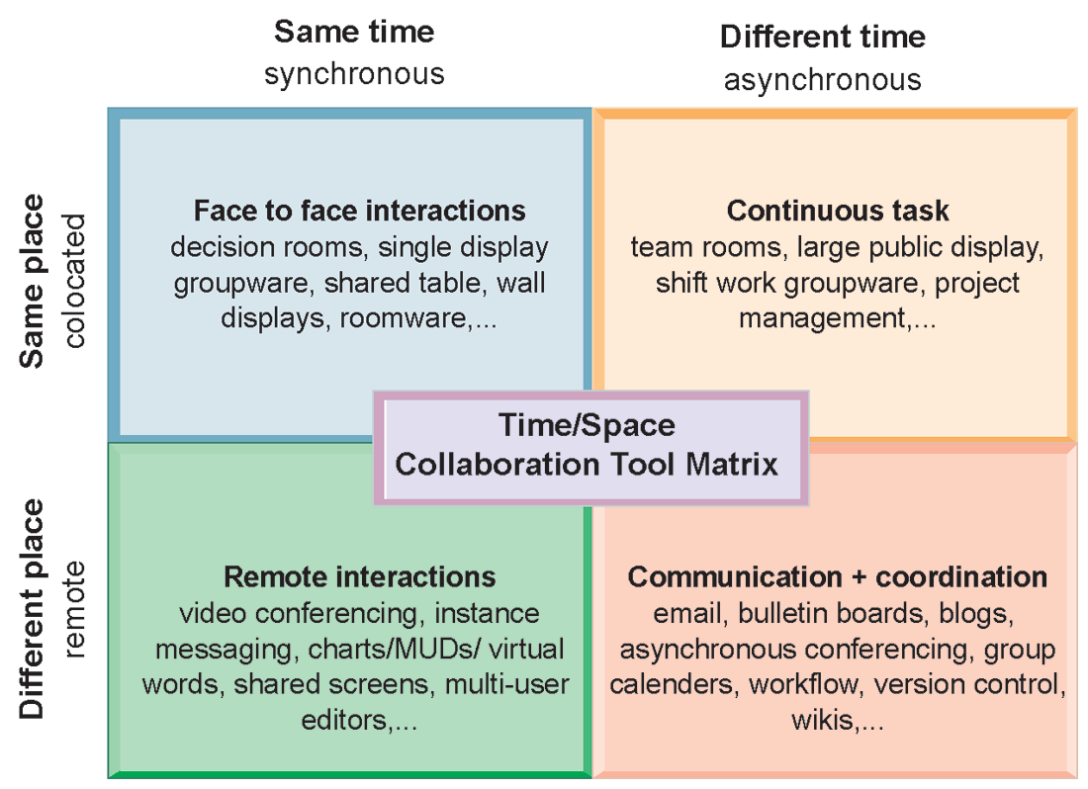
The Time/Space Collaboration Tool Matrix
FIGURE 2-8
Collaboration technologies can be classified in terms of whether they support interactions at the same or different time or place or whether these interactions are remote or co-located.
Notes:
You can use this matrix to identify solutions to the time/location issues that face a firm, and to choose specific collaboration technologies.

Slide 48
The Information Systems Function in Business
Information systems department:
  Formal organizational unit responsible for information technology services
  Often headed by chief information officer (CIO)
    Other senior positions include chief security officer (CSO), chief knowledge officer (CKO), chief privacy officer (CPO)
  Programmers
  Systems analysts
  Information systems managers
Notes:
Defined simply, the information systems department of a firm is responsible for coordinating all of the systems previously mentioned in this chapter. How the department is organized depends on the nature and size of the business. Small companies may not have a formal department, whereas large companies may have several departments for different business functions, or they have an IT Department in each corporate division. Ask students what types of information systems departments they have had experience with.

Slide 49
The Information Systems Function in Business
End users
  Representatives of other departments for whom applications are developed
  Increasing role in system design, development
IT Governance:
  Strategies and policies for using IT in the organization
  Decision rights
  Accountability
  Organization of information systems function
    Centralized, decentralized, and so on
Notes:
As the development of business information systems matures, end users have been increasingly recognized as pivotal to developing a successful system. In addition, the information systems department has also been recognized as a powerful resource for developing new products, services, and efficiencies. As such, IT governance is a central business concern—being able to use IT efficiently and effectively has become more and more essential to a business’s success.

