Slide 1

COMBINED PAGING AND SEGMENTATION

Slide 2
CONTENTS
A small review of Paging
Segmentation
Combined Segmentation and Paging
Examples

Slide 3
PAGING
allows the physical address space of a process to be
non-contiguous
Extends to any levels
Pages
PAGING
PTBR and PTLR
Page Frames
CPU generated Logical Address
Page# Offset
FrameTable
(One of the Main Memory)
PageTable
(One for each Process)

Slide 4
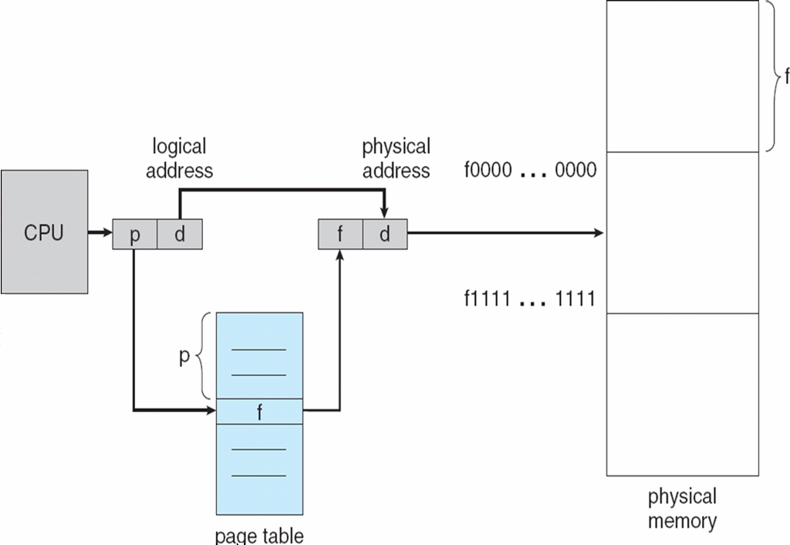
PAGING HARDWARE

Slide 5
EXAMPLE-LOGICAL TO PHYSICAL ADDRESS TRANSLATION IN PAGING
16-bit logical address
6-bit page #
10-bit offset #
0 | 0 | 0 | 0 | 0 | 1 | 0 | 1 | 1 | 1 | 0 | 1 | 1 | 1 | 0
Page Table
0 | 0 | 0 | 0 | 1 | 0 | 1
1 | 0 | 0 | 0 | 1 | 1 | 0
0 | 0 | 0 | 1 | 1 | 0 | 0 | 1 | 1 | 1 | 0 | 1 | 1 | 1 | 1 | 0
16-bit Physical address

Slide 6
DISADVANTAGES
ADVANTAGES
No external Fragmentation
Simple memory management algorithm
Swapping is easy (Equal sized Pages and Page Frames)
Internal fragmentation
Page tables may consume more memory.
Multi level paging leads to memory reference overhead.

Slide 7
HOW DOES USER VIEW MEMORY??
An important part of the memory management is that become unavoidable with paging is the separation of the user’s view of the memory and the actual physical memory
The users view is mapped to the physical memory
Thus the differentiation comes between the logical and physical memory.
Do users view memory as linear array of bytes some containing instruction and other containing data???
No…Rather they would see it as collection of segments…….

Slide 8
SEGMENTATION
It is a memory-management scheme that supports user view of memory.
Here main memory is not partitioned.
When user program is compiled , compiler automatically constructs segments.
The program segments are specified by programmer to the compiler (Decision made by the programmer)
Each segment may be code of a single procedure, the data of an array, or the collection of all local data values used by a particular module.
A program is a collection of segments which is a logical unit which may be of unequal size.

Slide 9
SO HOW IS IT FOR C COMPILER???
Code
Global Variables
Heap
Stack
The standard C library
C COMPILER

Slide 10
LOGICAL ADDRESSING IN SEGMENTATION
Logical Address space
Segment number
Offset
The mapping of the logical address to the physical address is done with the help of the segment table.
the length of the segment
SEGMENT TABLE
Segment Limit | Segment Base | Other bits
A bit is needed to determine if the segment is already in main memory (P)
Another bit is needed to determine if the segment has been modified since it was loaded in main memory (M)
starting address of the
corresponding segment in main mem

Slide 11
The segments of a program can be placed anywhere in the main memory.
For each process in each execution, there is one segment address table.
Segment-table base register (STBR) points to the segment table’s location in memory
Segment-table length register (STLR) indicates number of segments used by a program

Slide 12
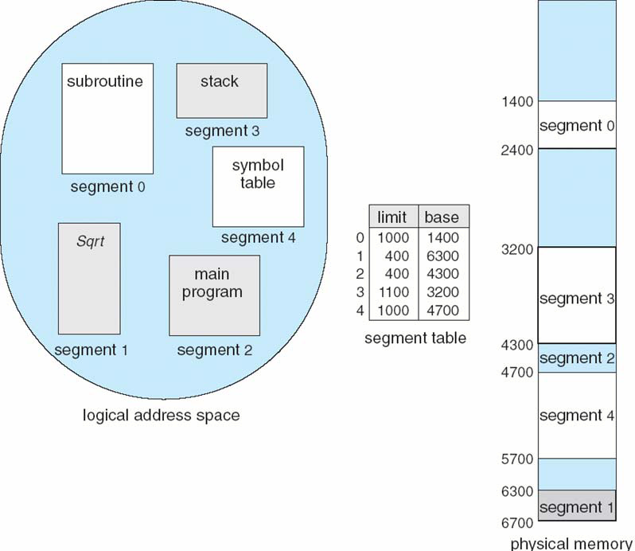
EXAMPLE OF SEGMENTATION

Slide 13
EXAMPLE-LOGICAL TO PHYSICAL ADDRESS TRANSLATION IN SEGMENTATION
16-bit logical address
12-bit offset #
0 | 0 | 0 | 1 | 0 | 0 | 0 | 1 | 1 | 1 | 0 | 1 | 1 | 1 | 0
Segment Table
Length
Base
0 | 0 | 0 | 1 | 0 | 1 | 1 | 1 | 0 | 1 | 1 | 1 | 0 | 0 | 0 | 0 | 0 | 0 | 1 | 0 | 0 | 0 | 0 | 0 | 0 | 0 | 0 | 0
1 | 0 | 1 | 1 | 1 | 1 | 0 | 0 | 1 | 1 | 1 | 1 | 0 | 0 | 0 | 1 | 0 | 0 | 0 | 0 | 0 | 0 | 1 | 0 | 0 | 0 | 0 | 0
12-bit offset #
16-bit seg base
0 | 0 | 1 | 0 | 0 | 0 | 1 | 1 | 0 | 0 | 0 | 1 | 0 | 0 | 0 | 0
16-bit Physical address

Slide 14
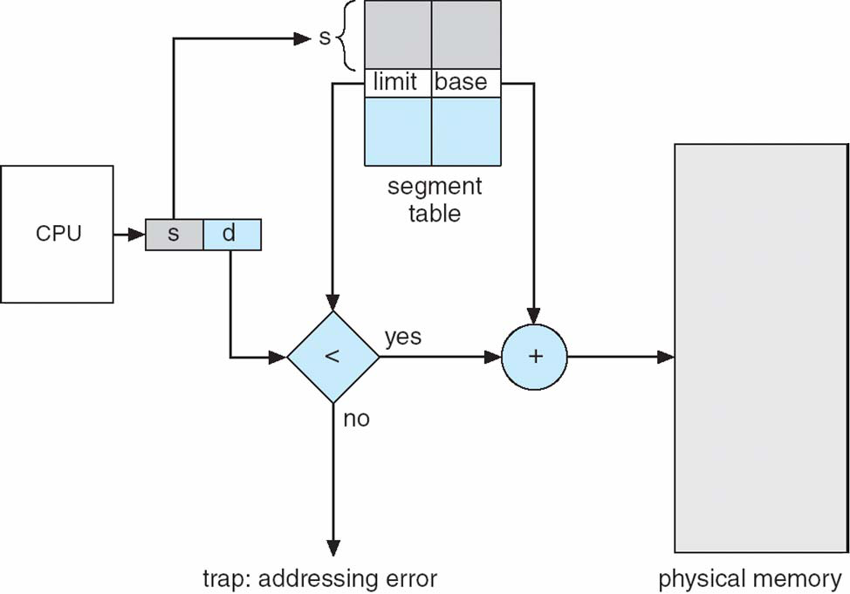
SEGMENTATION HARDWARE

Slide 15
Logical address
External fragmentation
Segment #
Offset
Seg 1
(code)
Seg 2
(data)
Physical
memory
Seg 3
(stack)
as in paging:
valid, modified,
protection, etc.
Seg 3
(stack)
Logical Memory
Segment table
Seg 1
(code)
MMU
offset <
limit ?
Base
Limit
Other
no
STBR
Seg 2
(data)
yes
STLR
memory
access fault
Segment Base + Offset
physical address
0x00

Slide 16
ADVANTAGES OF SEGMENTATION
No internal fragmentation
  Segment tables consume less memory than page tables ( only one entry per actual segment as opposed to one entry per page in Paging method)
  Because of the small segment table, memory reference is easy.
Lends itself to sharing data among processes.
Lends itself to protection.
As the individual lines of a page do not form one logical unit, it is not possible to set a particular access right to a page.
Note that each segment could be set up an access right

Slide 17

PROTECTION AND SHARING
Segmentation lends itself to the implementation of protection and sharing policies
Each entry has a base address and length so inadvertent memory access can be controlled
Sharing can be achieved by segments referencing multiple processes
Two processes that need to share access to a single segment would have the same segment name and address in their segment tables.
Notes:
Segmentation lends itself to the implementation of protection and sharing policies.
Because each segment table entry includes a length as well as a base address, a program
cannot inadvertently access a main memory location beyond the limits of a
segment. To achieve sharing, it is possible for a segment to be referenced in the segment
tables of more than one process. The same mechanisms are, of course, available
in a paging system. However, in this case the page structure of programs and
data is not visible to the programmer, making the specification of protection and
sharing requirements more awkward.

Slide 18
DISADVANTAGES
External fragmentation.
Costly memory management algorithm
Unequal size of segments is not good in the case of swapping.
So, why can’t we combine the ease of sharing and protection we get from segments with efficient memory utilization we get from pages ????

Slide 19
COMBINED SEGMENTATION AND PAGING
In a combined paging/segmentation system a user’s address space is broken up into a number of segments. Each segment is broken up into a number of fixed-sized pages which are equal in length to a main memory frame
Segmentation is visible to the programmer
Paging is transparent to the programmer

Slide 20
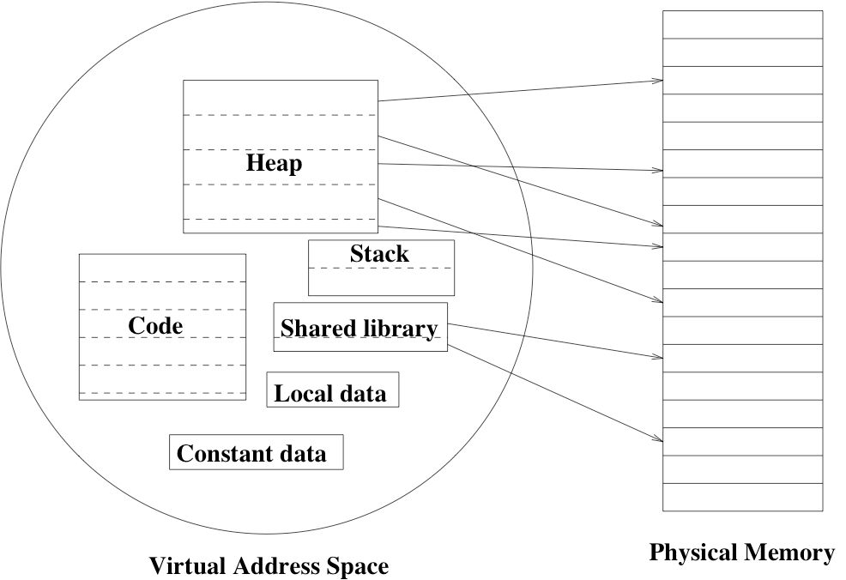
COMBINING SEGMENTS AND PAGING

Slide 21
IMPLEMENTING SEGMENTATION
Each process has:
  one segment table.
  several page tables : one page table per segment.
Logical Address space
Segment number : used to index the segment table who’s entry gives the starting address of the page table for that segment.
Page number : used to index that page table to obtain the corresponding frame number
Offset : used to locate the word within the frame.

Slide 22
ADDRESSES IN A SEGMENTED PAGING
SYSTEM
The segment number indexes into the segment table which yields the base address of the page table for that segment.
Check the remainder of the address (page number and offset) against the limit of the segment.
Use the page number to index the page table. The entry is the
frame. (The rest of this is just like paging.)
Concat the frame and the offset to get the physical address.

Slide 23
ADDRESS TRANSLATION
Segment limit
Page table base
CPU
yes
Physical memory
s
so
<
so
Logical address
no
p
po
Memory trap
+
Page table (for segment)
f
po
f

Slide 24
ADVANTAGES
Reduces memory usage as opposed to pure paging
  Page table size limited by segment size
  Segment table has only one entry per actual segment
Share individual pages by copying page table entries.
Share whole segments by sharing segment table entries, which is the same as sharing the page table for that segment.
Most advantages of paging still hold
  Simplifies memory allocation
  Eliminates external fragmentation.
  In general this system combines the efficiency in paging with the protection and sharing capabilities of the segmentation.

Slide 25
DISADVANTAGE
Internal fragmentation still exists…
Page 1
Process requests a 6KB address range
(4KB pages)
Page 2
internal fragmentation

Slide 26
EXAMPLE
The Intel Pentium
Supports both segmentation and segmentation with paging. CPU generates logical address given to segmentation unit which in turn is handed over to paging unit which generates physical address in main memory

Slide 27
EXAMPLE 1
Assume that a task is divided into four equal-sized segments and that the system builds an eight-entry page descriptor table for each segment. Thus, the system has a combination of segmentation and paging. Assume also that the page size is 2 Kbytes.
a. What is the maximum size of each segment?
b What is the maximum logical address space for the task?
c. Assume that an element in physical location 00021ABC is accessed by this task. What is the format of the logical address that the task generates for it? What is the maximum physical address space for the system?

Slide 28
SOLUTION
(8 entries in the page table) x 2K = 16K.
B. (16 K) x 4 segments per task = 64K.
The physical address is 32 bits wide total, so the frame number must be 21 bits wide. Thus 00021ABC is represented in binary as:
Frame Offset
0000 0000 0000 0010 0001 1 | 010 1011 1100
D. The maximum physical address space is 2³² = 4 GB

Slide 29
EXAMPLE-2
This question refers to an architecture using segmentation with paging. In this architecture, the 32-bit virtual address is divided into fields as follows:
4 bit segment number
12 bit page number
16 bit offset
Find the physical address corresponding to each of the following virtual addresses (answer "bad virtual address" if the virtual address is invalid)..
00000000
20022002
10015555

Slide 30
 | Segment table |  |  | Page table A |  |  | Page table B
0 | Page table A |  | 0 | CAFE |  | 0 | F000
1 | Page table B |  | 1 | DEAD |  | 1 | D8BF
x | (rest invalid) |  | 2 | BEEF |  | X | (rest invalid)
 |  |  | 3 | BA11
 |  |  | X

Slide 31
SOLUTION:
1. CAFE0000.
2. Bad virtual address.
3. D8BF5555.

Slide 32
REFERENCES….
Silberschatz,Galvin,Gange – Operating System Concepts (7th Ed)
William Stalling – Operating System
(6th Ed)

Slide 33
THANK YOU

