Slide 1
E-Mail
CSC 102 Lecture 9

Slide 2
Email Life Cycle
A
B
4.
Viewing
1.
Composition
Groupwise,
Eudora etc.
Groupwise,
Eudora etc.
5.
Archival
SMTP
POP/IMAP
Mail server
Mail server
3.
Queueing
2.
Transmission
TCP/IP

Slide 3

SMTP = Simple Mail Transport Protocol
“The goal of [SMTP] is to transfer mail reliably and efficiently.”
Email written in plain ASCII text
Uses TCP/IP for transmission
Flexible, expandable format
Trust-based -- no verification!

Slide 4
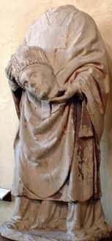
SMTP Format
Email begins with header
  Each header line begins with descriptor
  E.g.: To: Subject: Date: etc.
Blank line indicates end of header
Remainder of message is body
  Arbitrary format
  This is what shows up in your email reader

Slide 5
Sample Email
From: "British Telecom" <telecom02@9.cn>
Subject: One Million Pounds
Date: Fri, 09 Jul 2010 18:16:26 -0500
Content-Type: text/plain;charset=iso-8859-1; format="flowed"
Content-Transfer-Encoding: 8bit
One Million Pounds has been Awarded to in you in our BT
PROMO.Send your
Names...
Country...
Occupation...
Tel...
Age...
Header
Body
In Groupwise, view by clicking the Message Source tab (for external email only)

Slide 6

Postmarks
Mail servers often add lines to the header as they handle an email
Each server handling email adds Received line
  Received: from mscreen4.smith.edu ([131.229.64.70])
  by gwsmtp1.smith.edu with ESMTP; Tue, 23 Nov 2010 12:07:57 -0500
  Includes timestamp & source
  Like geologic layers: most recent at top
Spam checkers add annotations also
  X-NAI-Spam-Threshold-Checked: 4.5

Slide 7
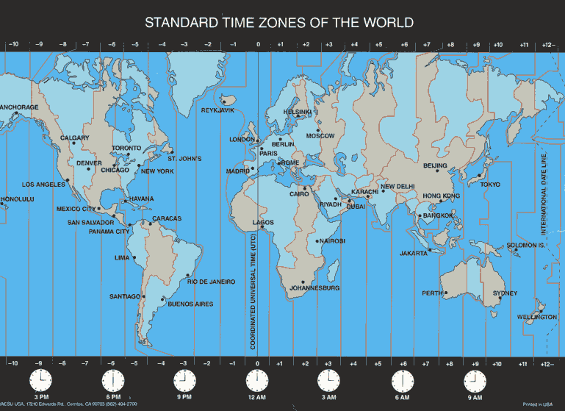
Timestamps
Tue, 23 Nov 2010 12:07:57 -0500
Standard formats for time and date
Time zone of server given last
  -0500 means 5 hours behind universal time
  - i.e., Eastern Standard Time
Timestamp comes from server’s system clock

Slide 8
Demo: Mail from Tooth Fairy
What can you figure out about this message?
  Return-path: <nhowe@cs.smith.edu>
  Received: from cs.smith.edu (scinix.smith.edu [131.229.72.8])
  by gwemail.smith.edu with ESMTP; Tue, 23 Nov 2010 13:28:42 -0500
  Received: from beowulf.csc.smith.edu (beowulf.csc.smith.edu [131.229.72.10])
  by cs.smith.edu (Postfix) with ESMTP id 0233FEEA77
  for <nhowe@smith.edu>; Tue, 23 Nov 2010 13:28:40 -0500 (EST)
  Received: (from nhowe@localhost)
  by beowulf.csc.smith.edu (8.14.4/8.14.4/Submit) id oANISdqM003861;
  Tue, 23 Nov 2010 13:28:39 -0500
  Date: Tue, 23 Nov 2010 13:28:39 -0500
  Message-Id: <201011231828.oANISdqM003861@beowulf.csc.smith.edu>
  From: tooth.fairy@fairyland.org
  To: nhowe@smith.edu
  Subject: Your Teeth
  Dear Nick,
  You haven't left any teeth for me in a very long time. Don't you believe in me any more?
  The Tooth Fairy
Notes:
/usr/sbin/sendmail –t < toothfairy.txt

Slide 9

Email Attachments
Early email was text-only: no attachments
People wanted convenience of sending files
MIME: Multipurpose Internet Mail Extensions
  Special format for body of email
  Split into parts, with header giving lengths & types
  Non-text files encoded as text
  Described in RFC 2045 & 2046

Slide 10

Sample MIME Content
MIME-Version: 1.0
Content-Type: multipart/mixed;
boundary="frontier"
This is a message with multiple parts in MIME format.
--frontier
Content-Type: text/plain
This is the body of the message.
--frontier
Content-Type: application/octet-stream
Content-Transfer-Encoding: base64
PGh0bWw+CiAgPGhlYWQ+CiAgPC9oZWFkPgogIDxib2R5PgogICAgPHA+VGhpcyBpcyB0aGUg Ym9keSBvZiB0aGUgbWVzc2FnZS48L3A+CiAgPC9ib2R5Pgo8L2h0bWw+Cg==
--frontier--

Slide 11
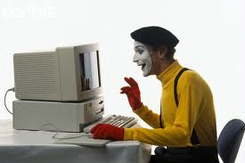
MIME Type
MIME standard classifies content
Guides recipient to proper display program
Each sort of content has a type and subtype
  text/plain (plain text)
  text/html (text with HTML tags)
  application/octet-stream (binary file)
  image/jpeg (JPEG image)
  video/mpeg (MPEG video file)
  audio/mpeg (MP3 audio file)

Slide 12

Other MIME Standards
RFC 2822 allows non-Latin characters in subject and other header lines
  Subject: =?iso-8859-1?Q?=A1Hola,_se=F1or!?=
  becomes: Subject: ¡Hola, señor!
MIME Content-Disposition header line can ask an attachment to open automatically
  Why is this dangerous?
  Most email programs now ignore this directive

Slide 13


Receiving Mail: POP & IMAP
POP = Post Office Protocol
  Messages stored temporarily on mail server
  Bulk download to single computer
  Minimizes connection time → Good for dial-up
IMAP = Internet Mail Access Protocol
  Mail archived on central server
  Accessible from any networked client
  More centralized & connection dependent

Slide 14
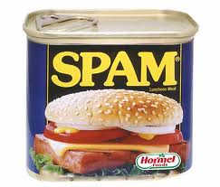
Spam Email
The Spam Skit
Spam: Unsolicited commercial email
  Not spam if prior business relationship exists
  Legitimate businesses must offer opt-out
Spam pays! (6-figure incomes. Why?)
Prevention mechanisms are an arms race
  Rule-based detectors look for keys (Viagra)
  Example-based detectors assess similarity to known spam

Slide 15
Smith & Spam (1)

Slide 16
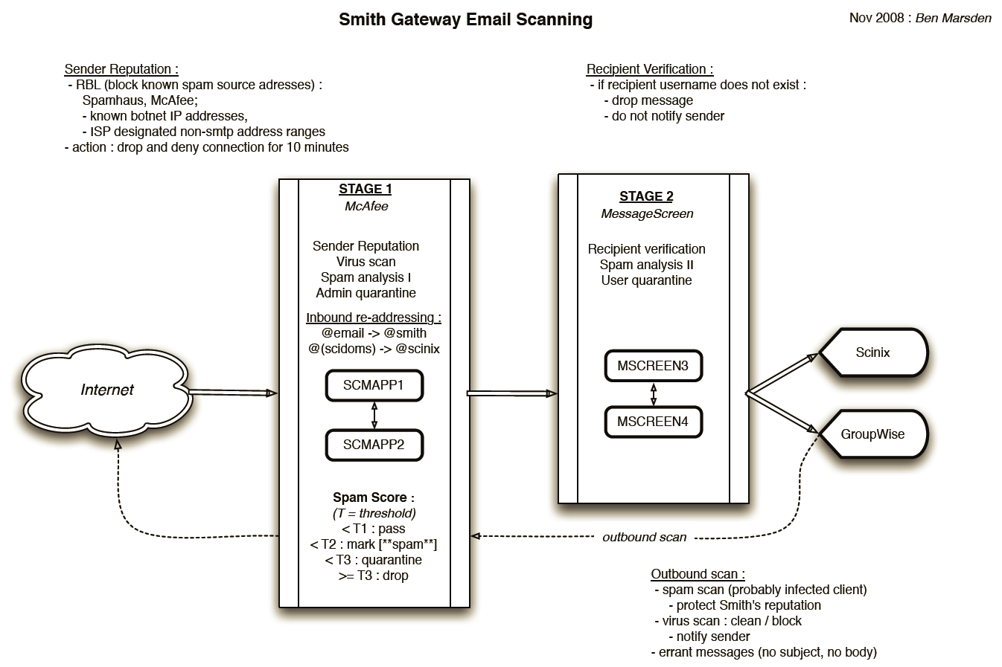
Smith & Spam (2)

