Slide 1
More HTML: Tables etc.
CSC 102 Lecture 6

Slide 2
HTML: Review
Web pages written in HTML
HTML = ordinary text + markup tags
  Tags use angle brackets: <>
  Specifies metainformation: structure, roles, etc.
Browser interprets HTML to display page
<html>
  <head>
    <title>Appears in Menu Bar</title>
  </head>
  <body>
    <p>This is the content.</p>
  </body>
</html>

Slide 3
Escape Codes
What if you want to display angle brackets?
  Browser can’t tell difference from a tag
  Need system for “special” characters
Web is World-Wide – non-Latin alphabets?
Solution: escape codes
Code | Symbol | Code | Symbol | Code | Symbol
&lt; | < | &euro; | € | &eacute; | é
&gt; | > | &pound; | £ | &ouml; | ö
&amp; | & | &cent; | ¢ | &ntilde; | ñ
&nbsp; |  | &copy; | © | &icirc; | î

Slide 4

HTML Lists
One tag surrounds the entire list
Other tags surround items in the list
Three types of lists: ordered, unordered, definition
<ol>
<li>First</li>
<li>Second</li>
<li>Third</li>
</ol>
<ul>
<li>Point</li>
<li>Point</li>
<li>Point</li>
</ul>
<dl>
<dt>Topic</dt>
<dd>Description</dd>
<dt>Topic</dt>
<dt>Description</dt>
</dl>

Slide 5
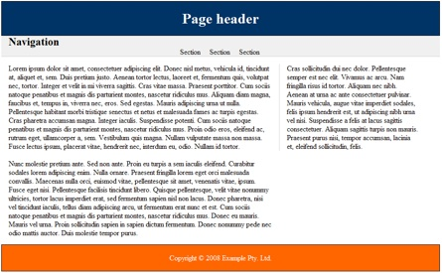
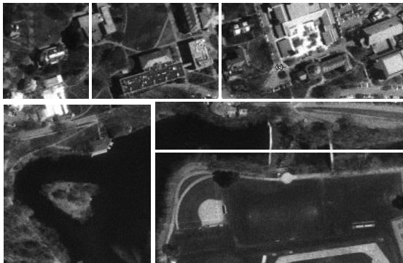
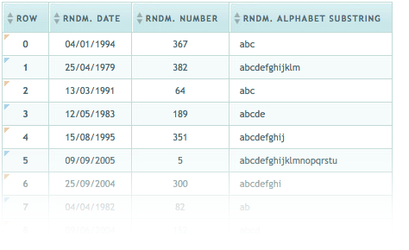
HTML Tables
Tables have many uses:
Data presentation
Page layout (now obsolete)
Special effects

Slide 6
Table Tags & Organization
Table is nested boxes
  <table> on outside
  Rows & caption within
    <tr> <caption>
  Data & header cells innermost
    <td> <th>
  Optional groupings
    <thead>, <tbody>, <tfoot>
Same # columns each row

Slide 7
Table Tags & Organization
<table>
<tr><th></th><th></th><th></th></tr>
<tr><td></td><td></td><td></td></tr>
<tr><td></td><td></td><td></td></tr>
<tr><td></td><td></td><td></td></tr>
<caption></caption>
</table>

Slide 8
Combining Cells
Cells may span multiple rows or columns
  <th rowspan="2">
  <td colspan="2">
May do both
Only describe first item in merged group
  First & third rows in example would list just two cells each
colspan="2"
rowspan="2"

Slide 9
Combining Cells
Cell deleted here
<table>
<tr><th></th> <th colspan="2"></th></tr>
<tr><td rowspan="2"> </td><td></td><td></td> </tr>
<tr><td></td><td></td><td></td></tr>
<tr><td></td><td></td></tr>
<caption></caption>
</table>
colspan="2"
rowspan="2"
Cell deleted here

Slide 10
Styles for Table Cells
You can set the background color
  <td style="background-color: red;">
You can set the height and width
    <td style="height:4in; width:2in;">
You can adjust the borders
    <table style="border-collapse: collapse; padding:0">
    <td style="border:1px solid black">
You can set the alignment within the cell
    <td style="text-align: center; valign: top;">
A
Full list of table properties

Slide 11
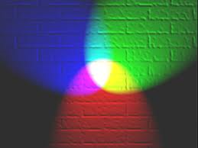
Color & HTML
HTML style rules recognize many color names
  17 original names + 140 added later
Can also mix your own from red, green, blue
  Amount from 0-255 of each, given in hexadecimal
  Format: #ABCDEF
  Use color picker if you like.
Red
Blue
Green

Slide 12
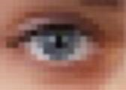

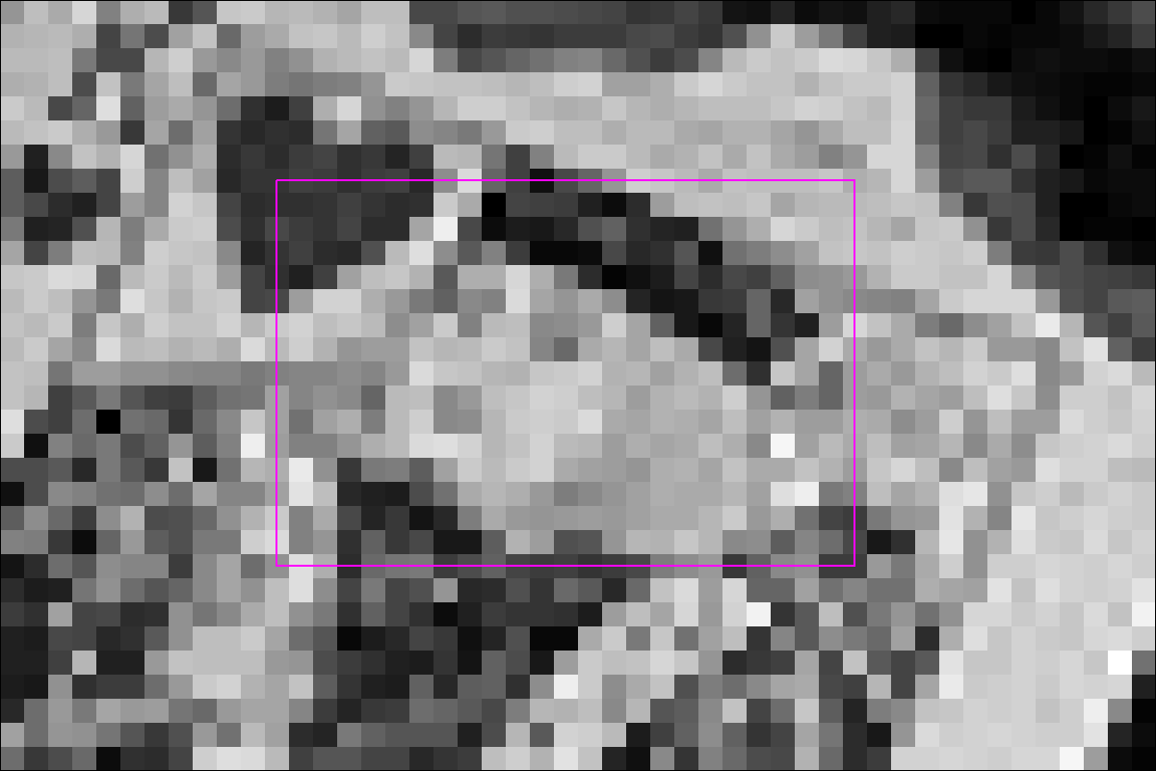
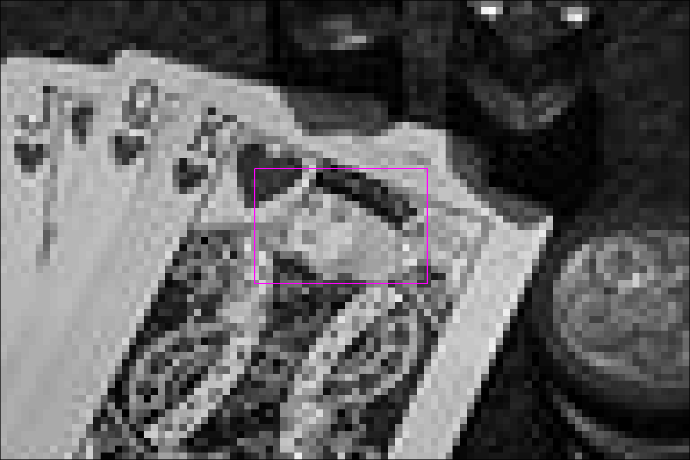
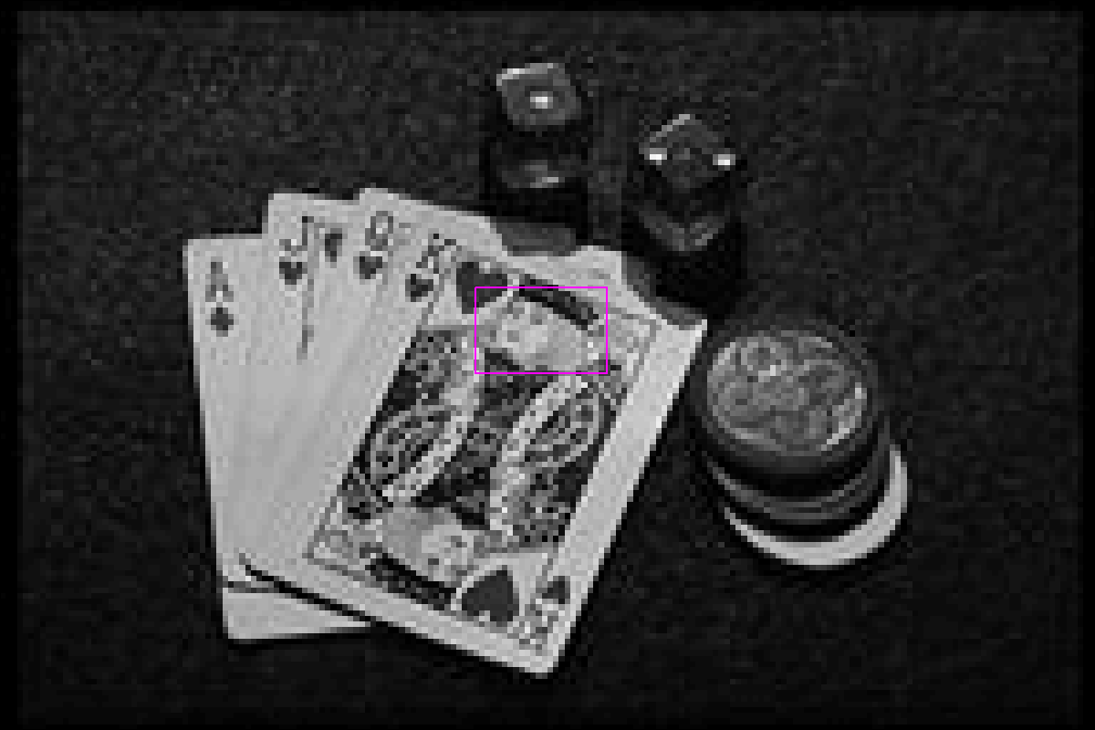
Images
Images are just grids of colored squares: pixels
One byte per pixel (grayscale) or 3B per pixel (color)
Transparency adds extra bit or byte per pixel
Many file formats store image pixel data
  Q. Which is better?
  A. Depends on the application!

Slide 13
Image File Formats
File Format | Compr- ession | Colors | Trans- parency | Notes | Web Usage
JPEG (Joint Photographic Expert Group) | Lossy Good | 256³ (all) | None | Best for natural images | Photos
PNG (Portable Network Graphics) | Exact Good | 256³ (all) | Full (256b) | Best transparency | Logos/ Icons
GIF (Graphics Interchange Format) | LZW Medium | 256 (limited) | Some (1b) | Supports simple animation | Anim-ations
BMP (Bitmap) | None | 256³ (all) | None | Windows only High bandwidth | No
RAW (Raw camera image) | None | 256³ (all) | None | Specialized uses | No
TIFF (Tagged Image File Format) | Varies | Varies | None | Not well supported | No

Slide 14
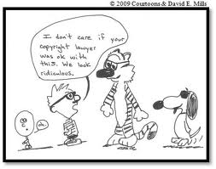

Images & Copyright
Rule: Assume that all content has a copyright attached, unless explicitly noted otherwise
Licenses:
  Public domain: pre-1923 or released by author; creations of U.S. government
  Copyleft/Creative Commons: permissive licenses; read the terms! Wikimedia is a source.
Fair use: some uses of copyrighted material
  limited/noncommercial (commentary, parody,educ.)
  cannot deprive owner of revenue
  only court-tested for written material

Slide 15
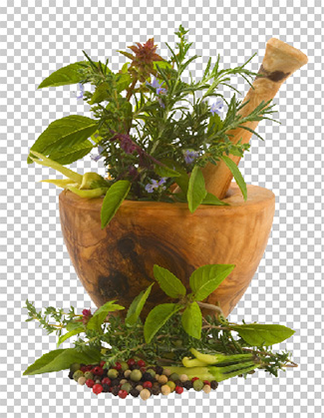
Photo Editing
Some images need alterations before use
  Need photo editing application
  Choices: Photoshop, Paint, Paint.Net, GIMP, etc.
Things you can do:
  Lower resolution (#pixels) ➔ faster downloads
  Lighten or darken image
  Crop unwanted areas
  Transparent background

Slide 16
Lab Activities
HTML Escape Codes & Lists
HTML Tables
Image Editing

