Slide 1
Introduction to HTML
CSC 102 Lecture 5

Slide 2
History
Year Version
1989 Tim Berners-Lee invented www
1991 Tim Berners-Lee invented HTML
1993 Dave Raggett drafted HTML+
1995 HTML Working Group defined HTML 2.0
1997 W3C Recommendation: HTML 3.2
1999 W3C Recommendation: HTML 4.01
2000 W3C Recommendation: XHTML 1.0
2008 WHATWG HTML5 First Public Draft
2012 WHATWG HTML5 Living Standard
2014 W3C Recommendation: HTML5
2016 W3C Candidate Recommendation: HTML 5.1

Slide 3
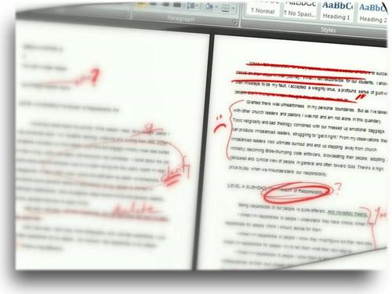
Markup
Take a look at a web page.
  What aspects of the appearance are not specified by the text itself?
  How does the browser know about them?
Meaning and appearance of parts of a page is specified by markup

Slide 4
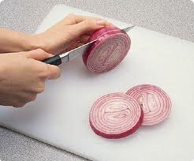
Tags
Markup tags inserted into text
  Not displayed verbatim by browser
  Instead used as indication of how to display
Tags enclosed by angle brackets: <tag>
Opening and closing tags surround content:
  <p>This is surrounded by paragraph tags</p>
  Note forward slash for the closing tag
  All tags must be closed. Some self-close: <hr />
  Tags must nest like onion skins
  Learn tags by example

Slide 5
Sample HTML
<html>
  <head>
    <title>Appears in Menu Bar</title>
  </head>
  <body>
    <p>This is the content.</p>
  </body>
</html>
Notes:
Demo with simpletext

Slide 6
Sample HTML
<html>
  <head>
    <title>Appears in Menu Bar</title>
  </head>
  <body>
    <p>This is the content.</p>
  </body>
</html>
The <html> tag encloses the entire document
Notes:
Demo with simpletext

Slide 7
Sample HTML
<html>
  <head>
    <title>Appears in Menu Bar</title>
  </head>
  <body>
    <p>This is the content.</p>
  </body>
</html>
The <head> tag encloses metainformation
describing the page
Notes:
Demo with simpletext

Slide 8
Sample HTML
<html>
  <head>
    <title>Appears in Menu Bar</title>
  </head>
  <body>
    <p>This is the content.</p>
  </body>
</html>
The <body> tag encloses all the actual page content
Notes:
Demo with simpletext

Slide 9
Sample HTML
<html>
  <head>
    <title>Appears in Menu Bar</title>
  </head>
  <body>
    <p>This is the content.</p>
  </body>
</html>
We can add more content and tags inside.
Notes:
Demo with simpletext

Slide 10
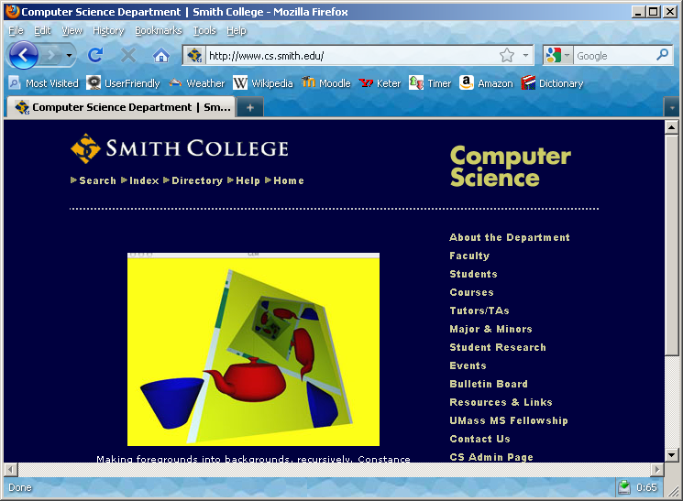
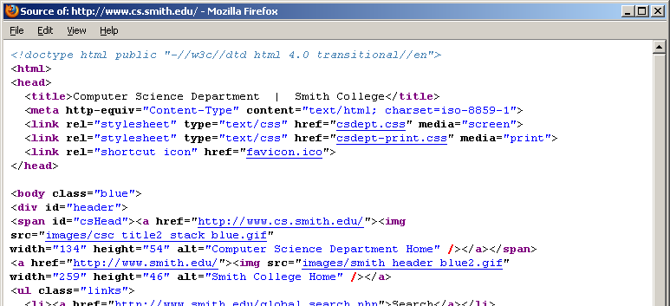
Browsers & HTML
Browser receives HTML from the web server
Interprets tags and displays accordingly
  You can see the original HTML via View Source
  Viewing other pages’ HTML = great way to learn!

Slide 11
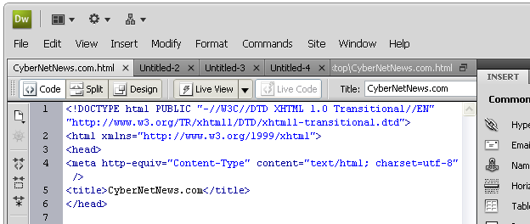
Dreamweaver
Dreamweaver and other products offer WYSIWYG web editors
  Can be useful, but be careful!
  You are responsible for the markup produced
  Use split view to see both markup & page at once
Useful for:
Filling in boilerplate
Closing tags automatically
Quickly seeing results

Slide 12
Best Practices
All tags are opening/closing pair or self-matched
Tags written in lower case
Prefer logical to physical tags (Why?)
  What something is, rather than how it should look
  Display preferences can be set later, in style sheet
Logical tags
Physical tags
<em>
<strong>
<kbd>
<acronym>
<address>
<blockquote>
<i>
<b>
<u>
<tt>
<big>
<small>
<font>
<blink>

Slide 13
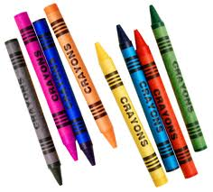
Tag Attributes
Tag behavior may be altered by an attribute
  <html xmlns="http://www.w3.org/1999/xhtml">
  This example specifies a particular flavor of html, defined at the URL shown
  Attributes appear only in opening tag, not closing
The style attribute governs appearance
  BLACK<span style="color:blue">BLUE</span> BLACK
  This example paints the word BLUE in blue
  We’ll learn other style specifications later
  Avoid <font> tag! (It’s deprecated.)

Slide 14
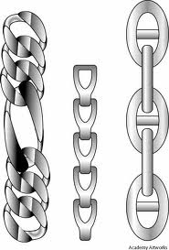
Hyperlinks
Links created using <a> tag
Include href attribute to specify the destination
Examples:
<a href="http://maven.smith.edu/~nhowe/102">CSC 102</a>
  Absolute link supplies a full URL
<a href="index.html">Home Page</a>
  Relative link supplies only the file name
    Protocol, host, and folder are same as current page
    May also have anchor/search information
Q. Which is better for use within a web site?

Slide 15
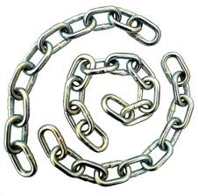

Hyperlinks and Anchors
You can also link to an anchor within a page
Links and anchors both made using the <a> tag
  Include an href attribute for a link
  Include a name attribute for an anchor
<a name="myAnchor">Anchor point</a>
…
<a href="#myAnchor">Link to anchor above</a>
<a href="http://example.com/page.html#section2">Link to anchor in external page</a>

Slide 16


Images
Image inserted using <img> tag
Include src attribute referencing separate file
Include alt attribute describing the image
  <img src="myPhoto.jpg" alt="My portrait" />
Browser loads image file separately & combines display
Optional attributes for more control:
  Setting dimensions: style="height: 180px"
    Can also set width, use units like in, cm, pt, etc.
    Careful not to change aspect!
  Floating: style="float: right"

Slide 17

Lab Activity
Try making your own web page!

