Slide 1
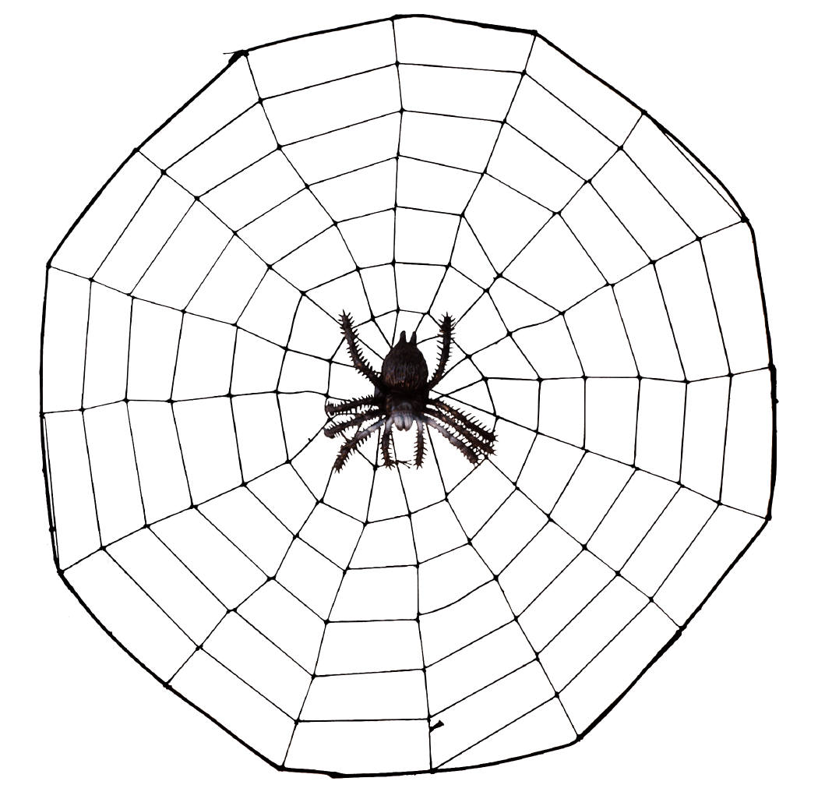
World Wide Web
CSC 102 Lecture 4

Slide 2
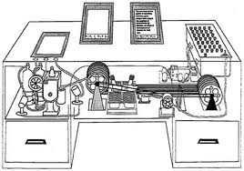
Precursors
1945: Vannevar Bush describes the “Memex”
  Knowledge on a desktop with cross-indices
1967: Ted Nelson, hypertext
  Word or phrase in one document leads to another
  Implemented “Xanadu” system in 1967
  Hypertext used later in Mac’s Hypercard program
Q. Why didn’t early hypertext succeed?

Slide 3
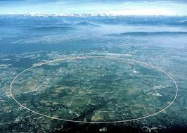
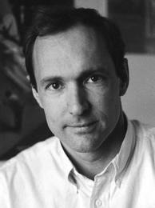



Early Development
1990: Tim Berners-Lee, Robert Cailliau use networked hypertext for documents at CERN
1991: First U.S. server at SLAC
1992: National Center for Supercomputing Applications releases free Mosaic browser
1993: Mosaic ported to Mac/Windows
  Jim Clark founds Netscape & hires Moasic team

Slide 4

Browser Wars! 1995-1997
Navigator 1.0 12/94
  - Plain HTML
1995
1996
1997
MSIE 1.0 8/95
MSIE 2.0 11/95
  - Plain HTML
Netscape ahead
Navigator 2.0 3/96
  - Java, Javascript, frames, cookies
MSIE 3.0 8/96
  Java, scripts, frames, styles
Navigator 3.0 8/96
  - Small improvements
Navigator 4.0 6/97
  Style sheets, some dynamic HTML
  W3C rejects layer model
MSIE 4.0 10/97
  - Style sheets, dynamic HTML
Microsoftahead
Navigator 5.0 not released
MSIE 5.0 3/99
Navigator 6.0 11/00

Slide 5


Web Standards
World Wide Web Consortium (W3C) formed 1994 to standardize web technology
  Early days: ratified innovations by browser makers
  Today: defines standards; browsers follow
Recent developments: HTML 5.0, CSS 3.0
Choice of browsers on market
Still in development
Acid test

Slide 6





Poll
What browser do you use most often?
(To answer in pairs):
What factors drive your choice of one browser over another?
Are there possible motivations you hadn’t considered before today?

Slide 7

Uniform Resource Locators
URL (or URI) specifies how to access any resource on the Internet (web page, etc.)
Conceptual:
More specific:
Protocol = rules for transmission of resource
  http = hypertext transfer protocol
  https = secure hypertext transfer protocol
  ftp = file transfer protocol
how://where/what
protocol://host/filepath

Slide 8

Uniform Resource Locators (2)
Host is either domain name or IP address
  Try http://74.125.226.113/, http://69.63.181.12/
File path gives location of file on that host
  Main folder is called the web root
  Path lists the subfolders to look in, separated by /
If no file name given, looks for a default file
  default.html or index.html on most systems
  No path: looks for the default file in the web root.

Slide 9


URL Extensions
Two extensions may follow the file in a URL
An anchor ID may indicate a particular spot in the file (if the file creator included anchors)
  Indicated by # followed by ID:
    example.com/file.html#partTwo
Key/value pairs may indicate search terms, form results or other information
  Indicated by ? followed by key=value pair(s)
    example.com/file.html?query=Smith&addr=Northampton
    http://www.mapquest.com/?q=Smith+College

Slide 10
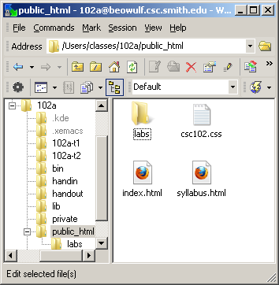
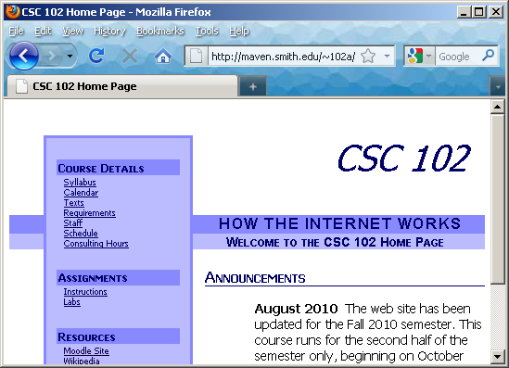
Web Files on Maven
The science web server is maven.smith.edu
Each student account has a public_html folder identified publicly as ~account_name

Slide 11

What is the URL?
File awesome.html is inside folder fantastic, which is in the web root. The host is really.stupendous.net.
You put a file called index.html inside the public_html folder of your course account
You create a folder called labs inside the public_html folder, with a file called lab1.html
You put a file called index.html in your root folder, next to the folder public_html

Slide 12


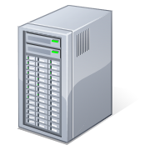
Client-Server Architecture
Client = Web browser
Issues page requests
Displays results
Server = Source of content
Responds to any request on port 80
Sends back pages
Like a short-order cook!

Slide 13
Page Service
User clicks link with URL
DNS query for IP address
IP address returned
Browser opens TCP session on port 80
Server TCP acknowledges
Browser issues GET for desired web page
Server retrieves from disk
TCP sends back in packets
File reassembled
TCP connection closed
Browser displays on screen
1
DNS Server
Web Server

Slide 14
Page Service
User clicks link with URL
DNS query for IP address
IP address returned
Browser opens TCP session on port 80
Server TCP acknowledges
Browser issues GET for desired web page
Server retrieves from disk
TCP sends back in packets
File reassembled
TCP connection closed
Browser displays on screen
2
DNS Server
Web Server

Slide 15
Page Service
User clicks link with URL
DNS query for IP address
IP address returned
Browser opens TCP session on port 80
Server TCP acknowledges
Browser issues GET for desired web page
Server retrieves from disk
TCP sends back in packets
File reassembled
TCP connection closed
Browser displays on screen
3
DNS Server
Web Server

Slide 16
Page Service
User clicks link with URL
DNS query for IP address
IP address returned
Browser opens TCP session on port 80
Server TCP acknowledges
Browser issues GET for desired web page
Server retrieves from disk
TCP sends back in packets
File reassembled
TCP connection closed
Browser displays on screen
DNS Server
4
Web Server

Slide 17
Page Service
User clicks link with URL
DNS query for IP address
IP address returned
Browser opens TCP session on port 80
Server TCP acknowledges
Browser issues GET for desired web page
Server retrieves from disk
TCP sends back in packets
File reassembled
TCP connection closed
Browser displays on screen
DNS Server
5
Web Server

Slide 18
Page Service
User clicks link with URL
DNS query for IP address
IP address returned
Browser opens TCP session on port 80
Server TCP acknowledges
Browser issues GET for desired web page
Server retrieves from disk
TCP sends back in packets
File reassembled
TCP connection closed
Browser displays on screen
DNS Server
6
Web Server

Slide 19
Page Service
User clicks link with URL
DNS query for IP address
IP address returned
Browser opens TCP session on port 80
Server TCP acknowledges
Browser issues GET for desired web page
Server retrieves from disk
TCP sends back in packets
File reassembled
TCP connection closed
Browser displays on screen
DNS Server
7
Web Server

Slide 20
Page Service
User clicks link with URL
DNS query for IP address
IP address returned
Browser opens TCP session on port 80
Server TCP acknowledges
Browser issues GET for desired web page
Server retrieves from disk
TCP sends back in packets
File reassembled
TCP connection closed
Browser displays on screen
DNS Server
8
Web Server

Slide 21
Page Service
User clicks link with URL
DNS query for IP address
IP address returned
Browser opens TCP session on port 80
Server TCP acknowledges
Browser issues GET for desired web page
Server retrieves from disk
TCP sends back in packets
File reassembled
TCP connection closed
Browser displays on screen
9
DNS Server
Web Server

Slide 22
Page Service
User clicks link with URL
DNS query for IP address
IP address returned
Browser opens TCP session on port 80
Server TCP acknowledges
Browser issues GET for desired web page
Server retrieves from disk
TCP sends back in packets
File reassembled
TCP connection closed
Browser displays on screen
DNS Server
10
Web Server

Slide 23
Page Service
User clicks link with URL
DNS query for IP address
IP address returned
Browser opens TCP session on port 80
Server TCP acknowledges
Browser issues GET for desired web page
Server retrieves from disk
TCP sends back in packets
File reassembled
TCP connection closed
Browser displays on screen
11
DNS Server
Web Server

Slide 24
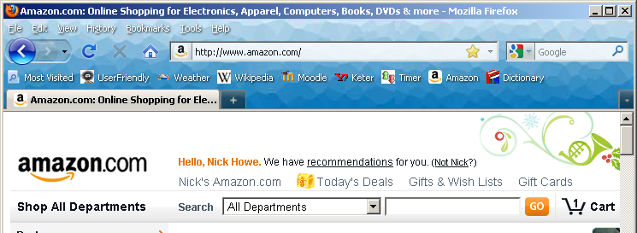
Demo: Telnet
We can pretend to be a web browser:
  telnet amazon.com 80 <CR>
  GET /home.html HTTP/1.0 <CR><CR>
If we were a browser, would use the results to display the page on our screen:

