Slide 1
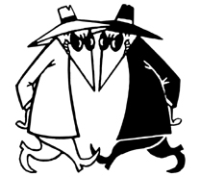
Cryptography & Security
CSC 103 Lecture 12
Nicholas R. Howe

Slide 2
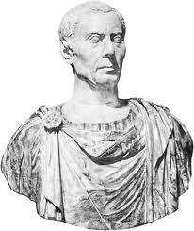
What does this message say?
Frqjudwxodwlrqv, brx kdyh iljxuhg rxw krz wr wudqvodwh wkh vhfuhw phvvdjh. Zhoo grqh!
How did you figure it out?
What techniques did you use?
Can you figure out the one below?
Oelp kz ymssfql cbwpvt kvllkxi. Zqp xpomjufc nqfgvk jlsszt bz grr ehivank ry kenn o vgxjhjnr ndr.

Slide 3

Encryption Schemes
The first shifts every letter by 3:
  Congratulations, you have figured out how to…
+ 333333333333333, 333 3333 3333333 333 333 33…
    Frqjudwxodwlrqv, brx kdyh iljxuhg rxw krz wr…
  The second uses a one-time pad:
  This is another secret message.
+ Vxdx ch yzezymu kxuyra yrttkre.
    Oelp kz ymssfql cbwpvt kvllkxi.
One-time pad is unbreakable if used just once.
  This would be ideal cipher
  The problem is distributing it!

Slide 4

Generated Cipher
E-commerce: Delivery of keys is a problem
Idea: generate pseudorandom ciphers using short keys
  Cipher sequence impossible to guess without key
  Still a problem of key delivery
Example: Key = 4-digit number
  Square it & take middle 4 digits
  Repeat using new key, etc.
4472
x 4472
19998784
9987
x 9987
99740169

Slide 5
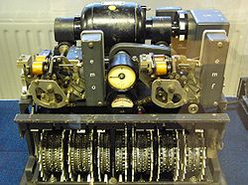
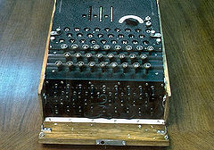
Codebreaking in WWII
Germans in WWII used mechanical cipher generators
Allies able to deduce mechanism and decipher messages
Significant factor in war effort
Early application of computers at Bletchley Park, U.K.
Interesting books on topic
Lorenz cipher
Enigma cipher

Slide 6
Code Breaking
Scenario: Alice wants to speak with Bob
Eve is listening to their communications
Can Alice and Bob converse without Eve learning anything?
Alice
Bob
Eve

Slide 7
Public Key Cryptography
Key distribution remains problem
1970s: Public key schemes published
Rely on one-way function
  Example: multiplying two numbers is easy
  Factoring a number into two components is hard
Setup: two keys, one public, one private
  Encryption via one key is undone using the other
  Impossible* to decrypt otherwise
1531 x 1811 = ?
2772641 = ? x ?
M
=M

Slide 8
Key Exchange
Alice and Bob independently select public & private keys
A
B
A
Alice
Bob
B
Eve

Slide 9
Key Exchange
Alice and Bob independently select public & private keys
Alice & Bob exchange public keys
B
A
B
A
A
Alice
Bob
B
B
A
Eve
B
A

Slide 10
Secure Communication (?)
Alice sends messages to Bob encrypted using Bob’s public key
Only Bob has the private key that can decrypt the message
M
A
B
B
A
Alice
?
Bob
B
B
A
Eve
B

Slide 11
Man In The Middle Attack
What if Eve is able to alter messages sent between Alice and Bob?
Eve can intercept key exchange & substitute new key!
A
A
E
B
A
Alice
Bob
B
A
E
Eve
E
E
A

Slide 12
Man In The Middle Attack
What if Eve is able to alter messages sent between Alice and Bob?
Eve can intercept key exchange & substitute new key!
All subsequent messages read & altered
A
M
M
B
E
E
A
Alice
Bob
B
E
A
A
E
Eve
E
E
A
B

Slide 13

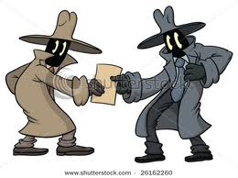
Secure Key Distribution
To prevent man-in-the-middle, must ensure correct identity of public keys
Need a trusted source to hold keys
Source must verify identity of entities for which it holds keys
  Verification in person, not electronically
  Keys also handed over in person
Web: trusted source is Certificate Authority

Slide 14
Certificates
Public/private keys can also establish identity
Browsers have CA public keys built in
  CA can send unforgeable messages
  Can distribute public keys for other sites
Secure, verifiable communication
M
This message can only be generated using the CA private key. It can be decoded using the CA public key.
CA
CA
M
Message readable only by B, sendable only by A
B
A

Slide 15

How Secure?
Best encryption systems based upon one-way functions with no known solution
Alternative is brute force: try every possible key
Time to break based upon key length
Key size | Time to Crack
40-bits (pre-1996) | Seconds
56 bits (DES) | Days
64 bits (RC5) | Years
128-256 bits (AES) | Secure (currently)

Slide 16

Crypto Algorithms
Many developments in 1990’s:
U.S. law prohibited export of crypto greater than 40 bits as “munitions”
Government using Data Encryption Standard (DES)
  54 bit key considered weak
  Fear of NSA “backdoor”
NIST announces competition for Advanced Encryption Standard (AES) in 1997, adopted 2000

Slide 17


Personal Crypto
You can make a personal encryption key
OpenPGP (Pretty Good Privacy) offers free encryption standards & tools
  Exchange public keys with friend
  Can encrypt email before sending
Can also create a key with public CA
  Must verify your identity to CA
  Send and receive encrypted messages in GMail

Slide 19
Key Exchange
Alice and Bob independently select public & private keys
Bob’s public key available from trusted source
Alice sends her public key to Bob encoded using Bob’s public key
Alice
Bob
Eve
A
B
A
B

Slide 20
Key Exchange
Alice and Bob independently select public & private keys
Bob’s public key available from trusted source
B
A
B
A
Alice
Bob
B
B
Eve
B

