Slide 1
Web Search
CSC 102 Lecture 12
Nicholas R. Howe

Slide 2
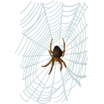

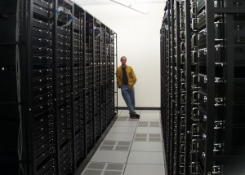
Data Collection
Web crawler/bot/spider: traverse links & collect pages
  Most of web is single clump
  Some pages deliberately omitted (databases, etc.)
How often to update?
  Google: is once an hour fast enough?
Archived on huge server farms
  2006: 850 TB on 25K servers
  Library of Congress = 20 TB

Slide 3


Search Model
User provides keyword query
  Search provider retrieves & ranks relevant pages
  Critical factors: relevance of results, speed
Ads also served based upon relevance
  Advertisers bid for keywords, pay for clicks
  Google chooses which ads to display based on expected revenue (expected clicks x price bid)
Q. How to judge relevance automatically?

Slide 4

Ranking: Bag of Words
Dominant method B.G. (Before Google)
Concept: page ranking based on frequency of keyword appearances
  Context not considered
  Word order not considered
  Pages boost rank by including keyword lists
All forms converted to word stem
  runs, runner, running → run-

Slide 5

Query Augmentation
What about pages with words related to a query?
  “Sports” vs. “Athletics”
  “Roses” vs. “Flowers”
Query augmentation:
  Initial retrieval on query (results not shown to user)
  Identify common words in top pages & add to query
  Display results from augmented query

Slide 6
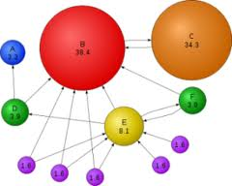
Authority-Based Search
Bag-of-Words bad at identifying useful pages
  Blather not useful; keyword lists not useful
  Need new way to identify good pages!
Idea: Harness existing human knowledge
  Useful pages attract many links
  Authority: many pages point to it
  Hub: points to many authorities
Rerank pages with authorities at top
http://www.prchecker.info/check_page_rank.php

Slide 7
PageRank Algorithm
All pages start with equal PageRank
They keep a little (15%) and split the rest among their links
After many rounds, well-linked pages have high rank
Poorly linked pages have low rank
A
0.15
B
0.15
C
0.15
D
0.58
E
1.85
F
0.58
G
0.70
H
1.30
I
1.00

Slide 8


Why Newsgroup Spam?
Link from site with high PageRank can lift web site out of obscurity
  Businesses will pay for higher rankings
  Consultants raise rankings for pay
  Posts on newsgroup sites can include links
Defense is the CAPTCHA
  “Completely Automated Public Turing test to tell Humans and Computers Apart”

Slide 9
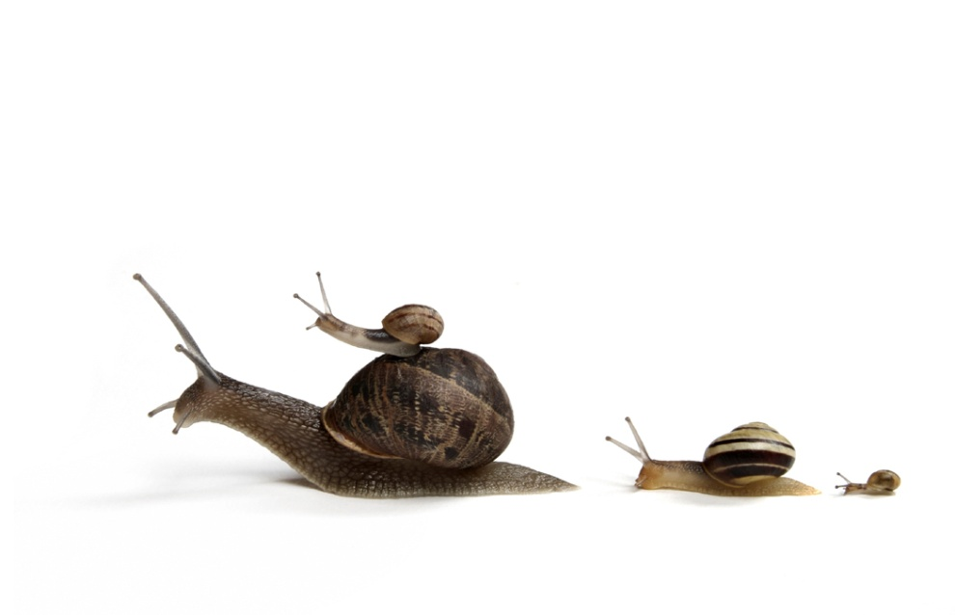
The nofollow Attribute
Google introduced a new attribute on links:
  <a href=“link.html” nofollow=“nofollow”>link</a>
Indicates that link should not count for authority analysis
  Newsgroups & discussion boards can add this attribute to all embedded links
  Apparently many do not
  Also allows link shaping: intentionally emphasizing certain links/sites over others

Slide 10
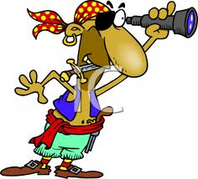
Smart Search
You’ve probably been doing web searches all your life
What strategies do you use when feaced with a difficult search problem? [Discuss]

Slide 11

Search Strategies
General Advice
  Consider type of query in light of goal
  Switch strategies when approach not working
  Assess credibility of all sources!
Specific techniques
  Add keywords (Christ → Christ Smith)
  Use quotes for phrases (“Carol Christ”)
  Exclusion/inclusion (Christ –Jesus +Carol)
  Advanced Search offers many other options

Slide 12
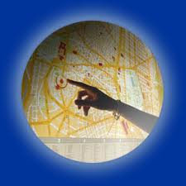

Search Variants
Local Search is restricted by geography
  Include zip code or address in search terms
  Returns hits ranked by relevance and location
Image Search returns images related to query
  Based upon surrounding words, not on actual image appearance
  Query By Image Content is more difficult
  Data gathering: Google Image Labeler

Slide 13

Wolfram Alpha
Combination of search engine and
automatic almanac
  Pulls information off web & reformats
  Can compute some answers from others
Examples:
  ASCII
  Blood donation
http://www.wolframalpha.com/

Slide 14
Lab
Try out the lab on search methods

Slide 15
A
H
A
H

