Slide 1
Personal Safety Online
CSC 102 Lecture 10

Slide 2
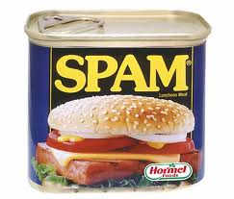
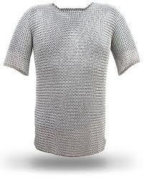
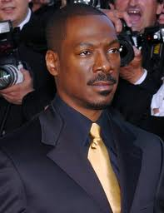
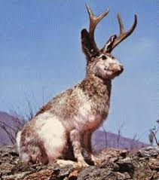
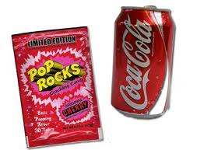
Nuisance Email
Spam
Chainmail
Urban Legends

Slide 3

Chainmail
Urges you to forward on to multiple recipients
  May offer riches
  May threaten dire bad luck
  May make sentimental appeal
Some add name to list / ask for reply back
Disallowed under Smith’s computer policy
Why is it a problem?
  Exponential growth
  Mill Cove School: 150 replies/hr after 9 days

Slide 4

Urban Legends
Usually feature a catchy/quirky story
  May make fantastic claims
  May appeal to some authority to claim veracity
    “I didn’t believe it at first, but Bill Gates confirmed it.”
Spread misinformation
  No overt harm
  Waste time, abuse public trust
Debunking: snopes.com, others

Slide 5

Phishing
Attempt to gain personal information via electronic fraud (e.g., email)
  Identity theft is goal
  Social engineering: fool user into trust
  Prompt immediate action (account to be closed!)
Spear phishing: Email can include personalized details to make is seem real
Reloading scam: try to sting victims twice
May link to fake web site (pharming)

Slide 6
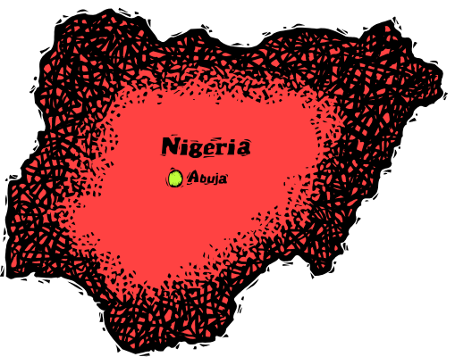
Nigerian/419 Fraud
Particular category of phishing
  Allegedly started by Nigerian university students
  Article 419 of Nigerian law governs fraud
Business proposal of $22.4m for you.Reply back to (jpoon818hk@yahoo.cn) if you are interested
Hello,
This is Harry Barnes of the 1st Battalion Scots Guard, but redeployed to Iraq, and at present stationed in Mushirij South West of Basra. I will like to share some very vital information that would bring some good financial returns to us in just a few weeks or days depending on how fast we pursue the matter.
I am seeking your assistance to evacuate the sum of $12.7m to you,as far as I can be assured that it will be safe in your care until I complete my service here.
This may not be the best medium to make this kind of contact because of the numerous scam offers transmitted through the Internet, but it is all I have access to for now.
I will be very grateful if you can give me the opportunity to discuss this matter with you by assuring me that you will not use any part of it against me in anyway, I hope you understand my limitations here. Should you have reasons to reject this offer, please destroy this mail as any leakage will be too bad for us.
I will continue with the details when you signify your intention to work with me.
Respectfully,
Harry Barnes
Good day,
This department of Credit Suisse Cie SA was instructed to remit the total
contract sum of ,000,000.00 on your behalf as your payment hold by African
Union.
The transfer effects immediately as we confirm the following.
(i) The receiving bank account information of yours.
(ii) The direct telephone numbers of your account manager who will confirm
the receipt of the twelve millions US Dollars in your account.
Lastly, you are advice to make payment of .00 (Ninety-eight dollars) being
for transfer assessment/registration receipt to African Union, send the
fees via money gram or western union,the receiver's name hereunder:
Receiver's Name: Zecharia Ego-Madu
Address: Lagos, Nigeria.
Amount: .00
(iii)Forward the payment receipt with the receiving bank account
information of yours to us for immediate transfer of your fund. The fund
will confirm in your account within two
days.
Sincerely.
Regards,
Brady W. Dougan
Director
Credit Suisse Cie SA
Paradeplatz 8
8070 Zurich,
Switzerland

Slide 7
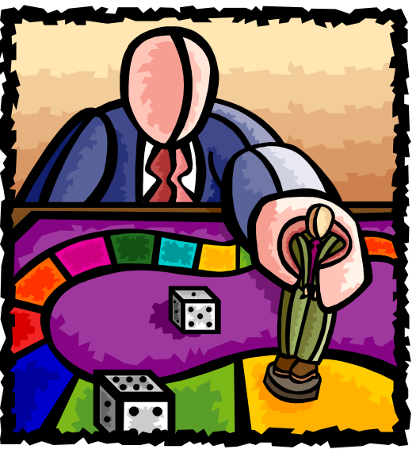
Game
Legit, scam, hoax, or spam?

Slide 8
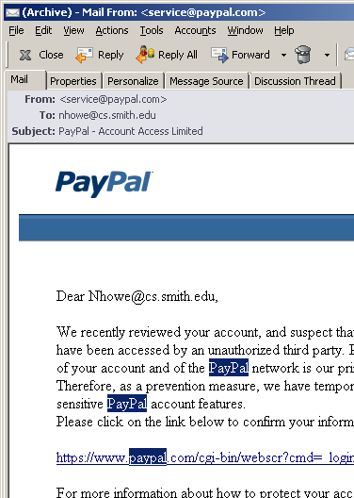
Precautions
Stop and Think
Know policies of company
  Would they contact you by email?
  Do they need the information?
Never give personal information to a web site linked in an email
  Navigate directly to site
  Check certificate in browser
Impersonal = warning sign
When in doubt, follow up by phone or postal mail

Slide 9

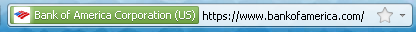
Pharming
Malicious website may masquerade as real
  Goal is to collect account passwords & other info
Many possible mechanisms
  Mistyped URL: www.bankofamercia.com
  Disguise URL in email link
  Poisoned DNS information
Check site certificates
  Green address bar?

Slide 10

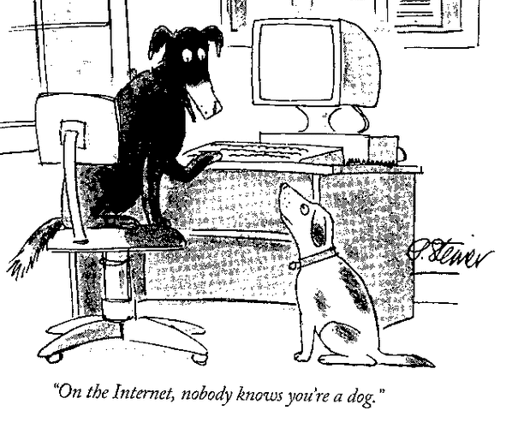
Certificates
  How can a site prove it is legitimate?
  Establishing electronic identity is hard
  Most people don’t care about details
Relies on chain of trust
  Browser trusts Verisign, etc.
  Verisign trusts company
  Issues certificate to confirm
    Customized & encoded
    Unforgeable

Slide 11
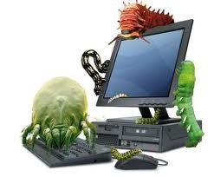
Malware
Fraud is not the only threat online
Hackers can install malware on your computer
  Malware = malevolent software
Most malware attacks are automatic & facilitated by the victim
  Reasonable precautions prevent most problems
    Keep software up to date
    Avoid simple passwords
  Active hacking normally targeted at big firms

Slide 12
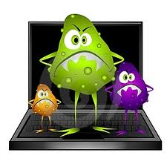

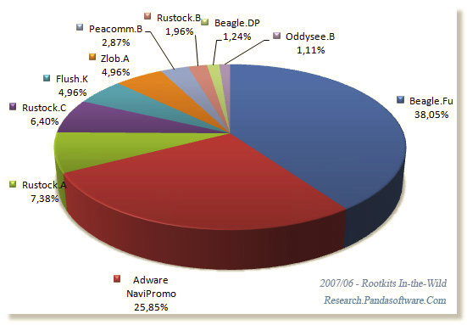
Types of Malware
Virus: attaches to program and runs with it
Worm: runs and spreads by itself
Trojan: seemingly legitimate software that installs malware
Adware: pops up advertising windows
Spyware: software that records actions & reads files stored on computer
Rootkit: gives hacker total control over computer

Slide 13
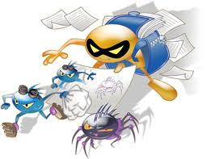
Facts About Malware
Windows primary target (market share!)
  Other platforms not immune, just less prone
New variants constantly developed – why?
  Showing off
  Profit motive
  International sabotage? Stuxnet virus for industry
Today, criminal activity more likely than prank
  Recruitment for botnets
  Mass collection of credit card numbers, etc.

Slide 14

How Is Malware Installed?
Run email attachment (autoview?)
Run downloaded program from internet
  Some web sites will prompt this
  Older browsers may allow automatic install
External installation via operating system or browser vulnerability
  Hackers analyze Microsoft patches
  Known attack modes included in hacker tools
Connect to infected hardware (USB stick)

Slide 15

Email Attachments
Distinction between types of attachments
  Running an unknown program is unsafe
  Viewing data is safe (trusted program displays)
Sometimes hard to tell the difference
  Executables, shell/batch files, Visual Basic all bad
  Images, sounds, videos, text files should be safe
  MS Office files with macros not safe
  Web sites probably safe if browser up to date
HTML-formatted email may disguise file type!
Hidden file extensions may also confuse

Slide 16
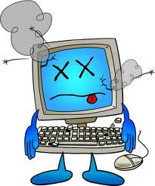
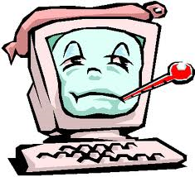
Got Malware?
Malware can bury itself in the OS
Solutions are fairly drastic
  Revert to prior condition via System Restore
  Reinstall operating system
Problem may recur if cause not addressed
 Best policy is to avoid trouble in the first place!

Slide 17


Precautions
Don’t run untrustworthy programs
Update software as recommended
Run firewall to prevent external attacks
Antivirus scanners detect minor infections
Turn off unneeded services (remote desktop)
Pick good passwords
Be alert to anything unusual

