Slide 1
Network Transmissions
How The Internet Works
Lecture 1
Sadi Evren SEKER

Slide 2
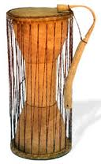
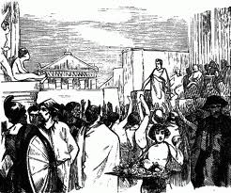


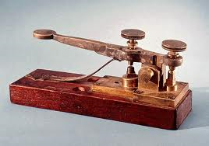
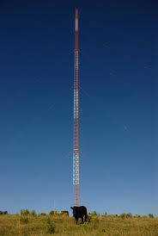


Is the Internet Different?
History: many types of communications
Notes:
Internet: more inclusive; bigger audience
Ask students what they want (fill out cards?)

Slide 3

Course Objective
Explore the technologies that make up the modern internet, and how they affect you
What is the Internet made of?
How does the Internet route transmissions and repair itself over time?
Why does email allow spam to proliferate?
How are web pages built?
Can I keep my data safe online?
Notes:
Try to get buy-in.

Slide 4
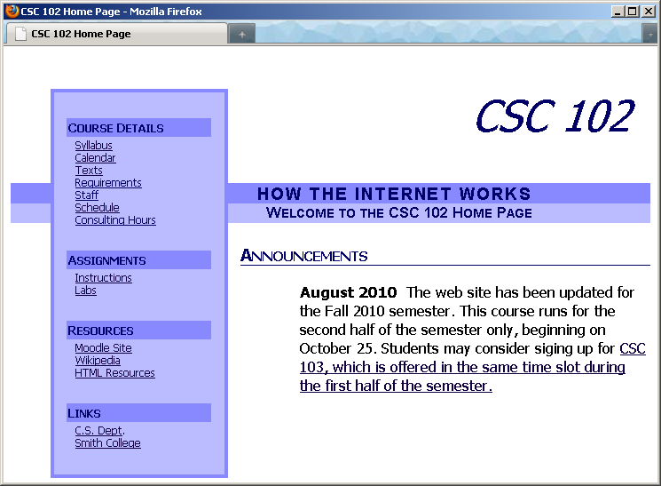
Student Responsibilities
Web: http://sadievrenseker.com/wp/?page_id=631
  Calendar: readings & assignments
  Syllabus
  Assignments
  Announcements
  Labs
Weekly homeworks
Take-home exam or paper/presentation
Notes:
Any logistics questions, ask now.

Slide 5

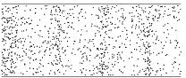
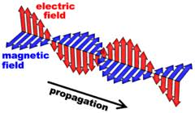
Network Basics
Hosts connected by a medium
Hosts send and receive signals
Medium transmits the signals across space
  Sound: Pressure wave in air
  Electrical: voltage change in a wire
  Optical: Light wave in a glass fiber
  Electromagnetic: Radio wave in space
Simplest transmission is a pulse (1 bit)
DEMO
Notes:
Demo with spring.

Slide 6
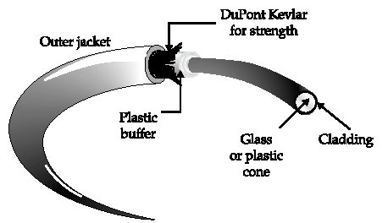

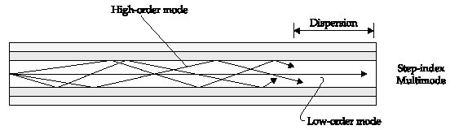
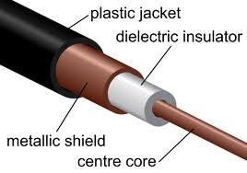
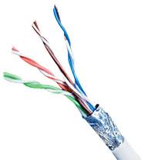
Network Media
Notes:
Tak about different media. Pass around ethernet wire.

Slide 7
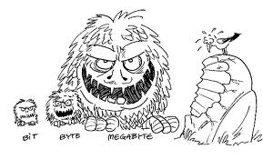
Information
Bit (b) = binary digit
  Two states: on/off, yes/no, 1/0, high/low, etc.
  Combine multiple bits for more complex data
    [Binary numbers, ASCII code, etc.]
Byte (B) = 8 bits
  Convenient unit; 256 possible values
  Metric/SI prefixes for larger amounts
  Confusion: kilo vs. kibi, etc.
Measures data storage, transfer

Slide 8
What is One Byte Worth?
Number from 0 to 255.
Grayscale from black to white
Single letter, number, punctuation mark, etc.
  ASCII: American Standard Code for Information Interchange
Letter | Binary | Letter | Binary | Letter | Binary | Letter | Binary
A | 1000001 | N | 1001110 | a | 1100001 | n | 1101110
B | 1000010 | O | 1001111 | b | 1100010 | o | 1101111
C | 1000011 | P | 1010000 | c | 1100011 | p | 1110000
D | 1000100 | Q | 1010001 | d | 1100100 | q | 1110001
E | 1000101 | R | 1010010 | e | 1100101 | r | 1110010
F | 1000110 | S | 1010011 | f | 1100110 | s | 1110011
G | 1000111 | T | 1010100 | g | 1100111 | t | 1110100
H | 1001000 | U | 1010101 | h | 1101000 | u | 1110101
I | 1001001 | V | 1010110 | i | 1101001 | v | 1110110
J | 1001010 | W | 1010111 | j | 1101010 | w | 1110111
K | 1001011 | X | 1011000 | k | 1101011 | x | 1111000
L | 1001100 | Y | 1011001 | l | 1101100 | y | 1111001
M | 1001101 | Z | 1011010 | m | 1101101 | z | 1111010
Table
Converter

Slide 9
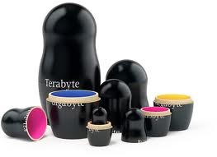
Quick Conversions
Taking turns with neighbor, convert these:
  1 kb to bits = ?
  2 kiB to bits = ?
  4800 b to kB = ?
  12.7 Gb to kb = ?
  512 MiB to bits = ?
  4096 kiB to MiB = ?
Use a calculator if you want!
kilo | k | 10³ | thousand | ≈ | 2¹⁰ | 1024 | ki | kibi
mega | M | 10⁶ | million | ≈ | 2²⁰ | 1,048,576 | Mi | mebi
giga | G | 10⁹ | billion | ≈ | 2³⁰ | 1,073,741,824 | Gi | gibi
tera | T | 10¹² | trillion | ≈ | 2⁴⁰ | 1,099,511,627,776 | Ti | tebi
Notes:
Go through factor-label method

Slide 10
Quick Conversions
Taking turns with neighbor, convert these:
  1 kb to bits = (1 kb)(1000 b/kb) = 1000 b
  2 kiB to bits = (2 kiB)(1024 b/kib)(8 b/B) = 16384 b
  4800 b to kB = (4800 b)(1 B/8 b)(1 kB/1000 B) = 0.6 kB
  12.7 Gb to kb = (12.7 Gb)(10⁹ Gb/b)(1 b/10³ kb) = 12.7x10⁶ kb
  512 MiB to bits = (512 MiB)(2²⁰ B/MiB)(8 b/B) = 4294967296 b
  4096 kiB to MiB = (4096 kiB)(2¹⁰ B/1 kiB)(1 MiB/2²⁰ B) = 4 MiB
kilo | k | 10³ | thousand | ≈ | 2¹⁰ | 1024 | ki | kibi
mega | M | 10⁶ | million | ≈ | 2²⁰ | 1,048,576 | Mi | mebi
giga | G | 10⁹ | billion | ≈ | 2³⁰ | 1,073,741,824 | Gi | gibi
tera | T | 10¹² | trillion | ≈ | 2⁴⁰ | 1,099,511,627,776 | Ti | tebi
Notes:
Go through factor-label method

Slide 11
Transmission
The Internet is designed to move information from place to place
This doesn’t happen instantaneously…
How can we make it happen more quickly?
01101000101001…
0010111110101001…

Slide 12


Transmission Rate
How should we measure transmission rate?
  Latency: time to accomplish task (i.e., download)
    Complete download (data file, web page, image)
    Streaming download (video, music)
  Signal Speed: velocity of waves (e.g., 70-80% light)
  Transfer Rate: amount of information in unit time
    Informally called “bandwidth”
    FCC 2010 broadband definition: 4 Mbps downstream

Slide 13

Measuring Transmission Rate
Transmission rate ≠ speed of the signals!
Count number of signals reaching endpoint
  Fast signals traveling far apart?
  Slow signals traveling close together?
 | Signal Speed
 | Low | High
Low | Dirt Road | Single lane highway
High | Traffic Jam | Expressway
Transmission
Capacity
Notes:
Reading War and Peace: does it matter how close to you I stand? How fast the speed of sound is?

Slide 14
Broadband
Q. How can we increase data transfer rates?
(Work in pairs; brainstorm ways)
Notes:
Do ball rolling demo

Slide 15

Broadband
Q. How can we increase data transfer rates?
Increasing signal propagation speed doesn’t work!
  Transit time is negligible (nanoseconds vs. hours)
    Signals spend more time waiting than traveling
  Physical limits: speed of light, sound

Slide 16
Broadband
Q. How can we increase data transfer rates?
A. Space signals closer together
  Too close: collisions! (Shannon limit)
  Redundancy & error correction help some
C
C
B
A
A
B

Slide 17
Broadband
Q. How can we increase data transfer rates?
A. Add extra channels
  May be expensive
  May be unavailable (think radio stations)

Slide 18
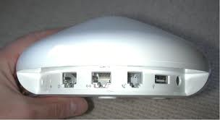
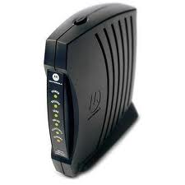
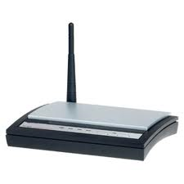
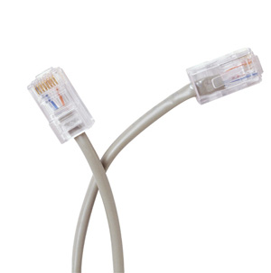
Typical Numbers
Modem: 56 kbps
  Converted to audible signals
DSL (Digital Subscriber Line): Up to 3 Mbps
  Electrical signals on phone lines
Cable “Modem”: Up to 30 Mbps
  Shared for neighborhood
Ethernet: up to 100 Gbps
  Smith uses this for campus network
Wireless: 54 Mbps (802.11g)

Slide 19
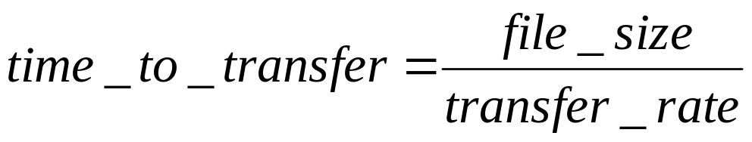
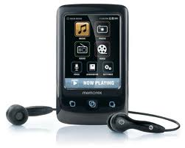
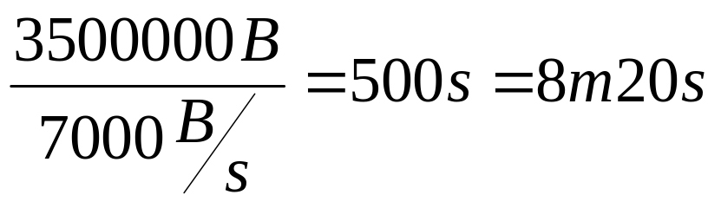
Computation: Total Transfer Time
Problem: 3.5 MB music file, 56 kbps modem. How long to transfer?
Make sure you convert to same units first!
  Convert MB to kb, or kb to MB
Best case answer!

Slide 20
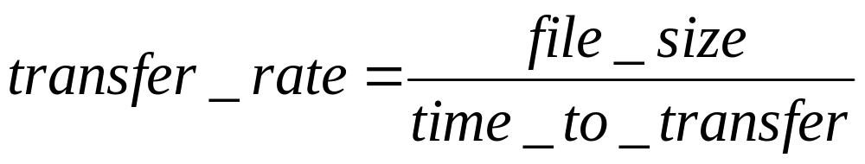
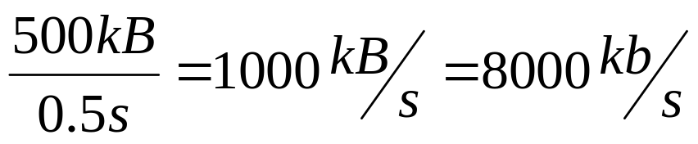

Computation: Actual Transfer Rate
Problem: 500 kB image takes 0.5 seconds to download. What was the transfer rate?
As before, convert units if necessary

Slide 21

Application
Two minute video file is 13 MB in size.
  What is the minimum bandwidth required to stream this without delay?
  If the actual bandwidth available is 56 kbps, how much of the video must be downloaded in advance for smooth play?
    Hint: how much can be downloaded in the two minutes of playing time? The rest must be completed in advance.

Slide 22
Review: Broadband
How can we increase data transfer rates?
Increase signal propagation speed
  Physical limits: speed of light, sound
Space signals closer together
  Equivalent to sending them more frequently
Add extra channels
  May be more expensive

Slide 23
More Quick Conversions
Taking turns with neighbor, write down the number of bits in the following:
  1 kb
  1 MB
  2 kiB
  12.7 Gb
  512 MiB
Use a calculator if you want!
kilo | k | 10³ | thousand | ≈ | 2¹⁰ | 1024 | ki | kibi
mega | M | 10⁶ | million | ≈ | 2²⁰ | 1,048,576 | Mi | mebi
giga | G | 10⁹ | billion | ≈ | 2³⁰ | 1,073,741,824 | Gi | gibi
tera | T | 10¹² | trillion | ≈ | 2⁴⁰ | 1,099,511,627,776 | Ti | tebi
Notes:
Run through answers

Slide 24
More Quick Conversions
Taking turns with neighbor, write down the number of bits in the following:
  1 kb 1000 b
  1 MB 1,000,000 B = 8,000,000 b
  2 kiB 2•1024 B = 2048 B = 16,384 b = 2¹⁴ b
  12.7 Gb 12.7 •10⁹ b = 12,700,000,000 b
  512 MiB 512 • 2²⁰ B = 8 • 2⁹ • 2²⁰ = 2³² b
kilo | k | 10³ | thousand | ≈ | 2¹⁰ | 1024 | ki | kibi
mega | M | 10⁶ | million | ≈ | 2²⁰ | 1,048,576 | Mi | mebi
giga | G | 10⁹ | billion | ≈ | 2³⁰ | 1,073,741,824 | Gi | gibi
tera | T | 10¹² | trillion | ≈ | 2⁴⁰ | 1,099,511,627,776 | Ti | tebi
Notes:
Run through answers

