Slide 1
Transforming Digital Reputation of Universities to the Reputation of Knowledge
Şadi Evren ŞEKER

Slide 2
Outline
Key Terms
  Digital Transformation
  Digital Society
  Reputation
  Reputation Index
  Knowledge Management
  Knowledge Economy
  Digital Reputation of Universities
Data
Methodology
Research Results
Conclusion

Slide 3

Digital Transformation
Digitization of Entities
  Wares to Software
  Governments to E-Governments to I-Government
  Democracy to E-Democracy to I-Democracy
  Societies to Digital Societies
  Living in an exponential time (Reaching 50 million)
    Telephone 75 Years
    Radio 38 Years
    TV 13 Years
    Internet 4 Years
    AngryBirds 35 Days

Slide 4

Digital Society
Evolving Web (Web 1.0, 2.0 and 3.0)
Bringing individuals alone in the space
Crowd Sourcing
  Un-Hierarchical Societies (Democratization)
  Reputation is determinant

Slide 5
Reputation
Reputation of Individuals in Crowds?
Reputation of organizations
Online Reputation (Digital Reputation, e-Reputation)
  Social Media Consultancy
  SEO
Notes:
What about academic quality? Quantity can not determine the reputation

Slide 6
Reputation Index
Advantages
  Creates a comparative listing
  Time Tracking is possible
  Connecting changes and events is possible

Slide 7

Evolving Web
Web 1.0, 2.0 and 3.0

Slide 8
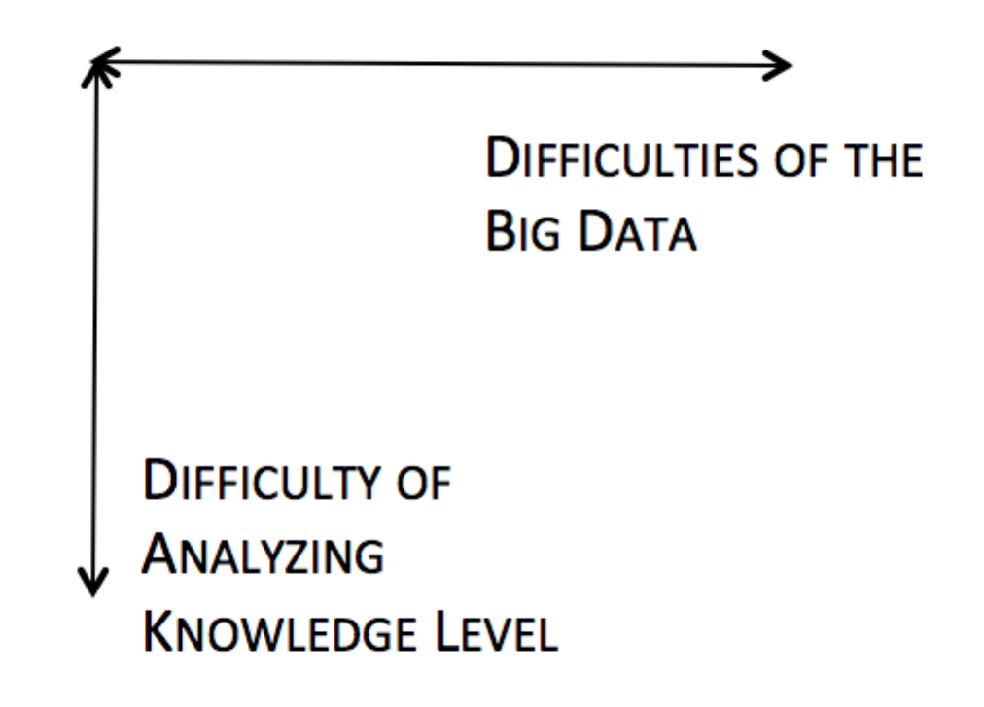
Challenges
volume,
velocity,
Veracity,
variety of the data

Slide 9
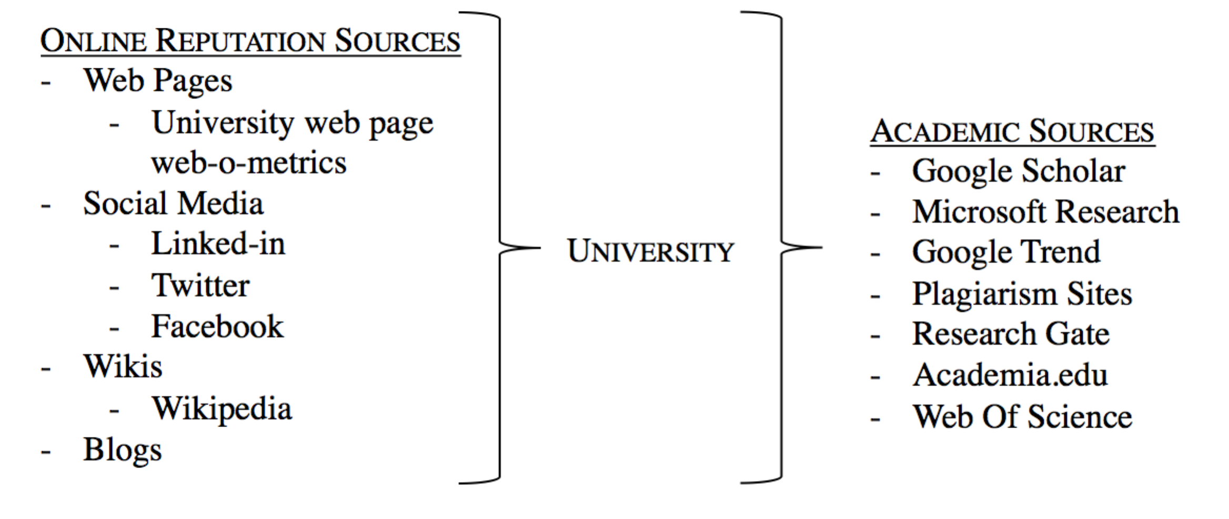
Transforming Digital Reputation of Universities to Knowledge

Slide 10
Methodology
Preprocessing and Normalization of data sources
Weighting the data sources
Applying linear regression
Calculating the Pearson’s r

Slide 11
Conclusion
The correlation coefficient for public universities is 0.81 and the private universities is 0.74 which means a 80% correlation exists between the online reputation and the knowledge produced in the university for Turkish case

Slide 12

Thank You & Questions
Assoc. Prof. Sadi Evren SEKER
www.SadiEvrenSEKER.com
academic@SadiEvrenSEKER.com

