Slide 1
Macroeconomic ICT Facts and Mobile Telecom Operators via Social Networks and Web Pages
Sadi Evren SEKER

Slide 2
questions
How do you compare GSM Operators from different countries?
How do you rank GSM Operators?
How do you calculate the digital reputation of GSM Operators?
How do you define the operational differences in countries for GSM operators?

Slide 3
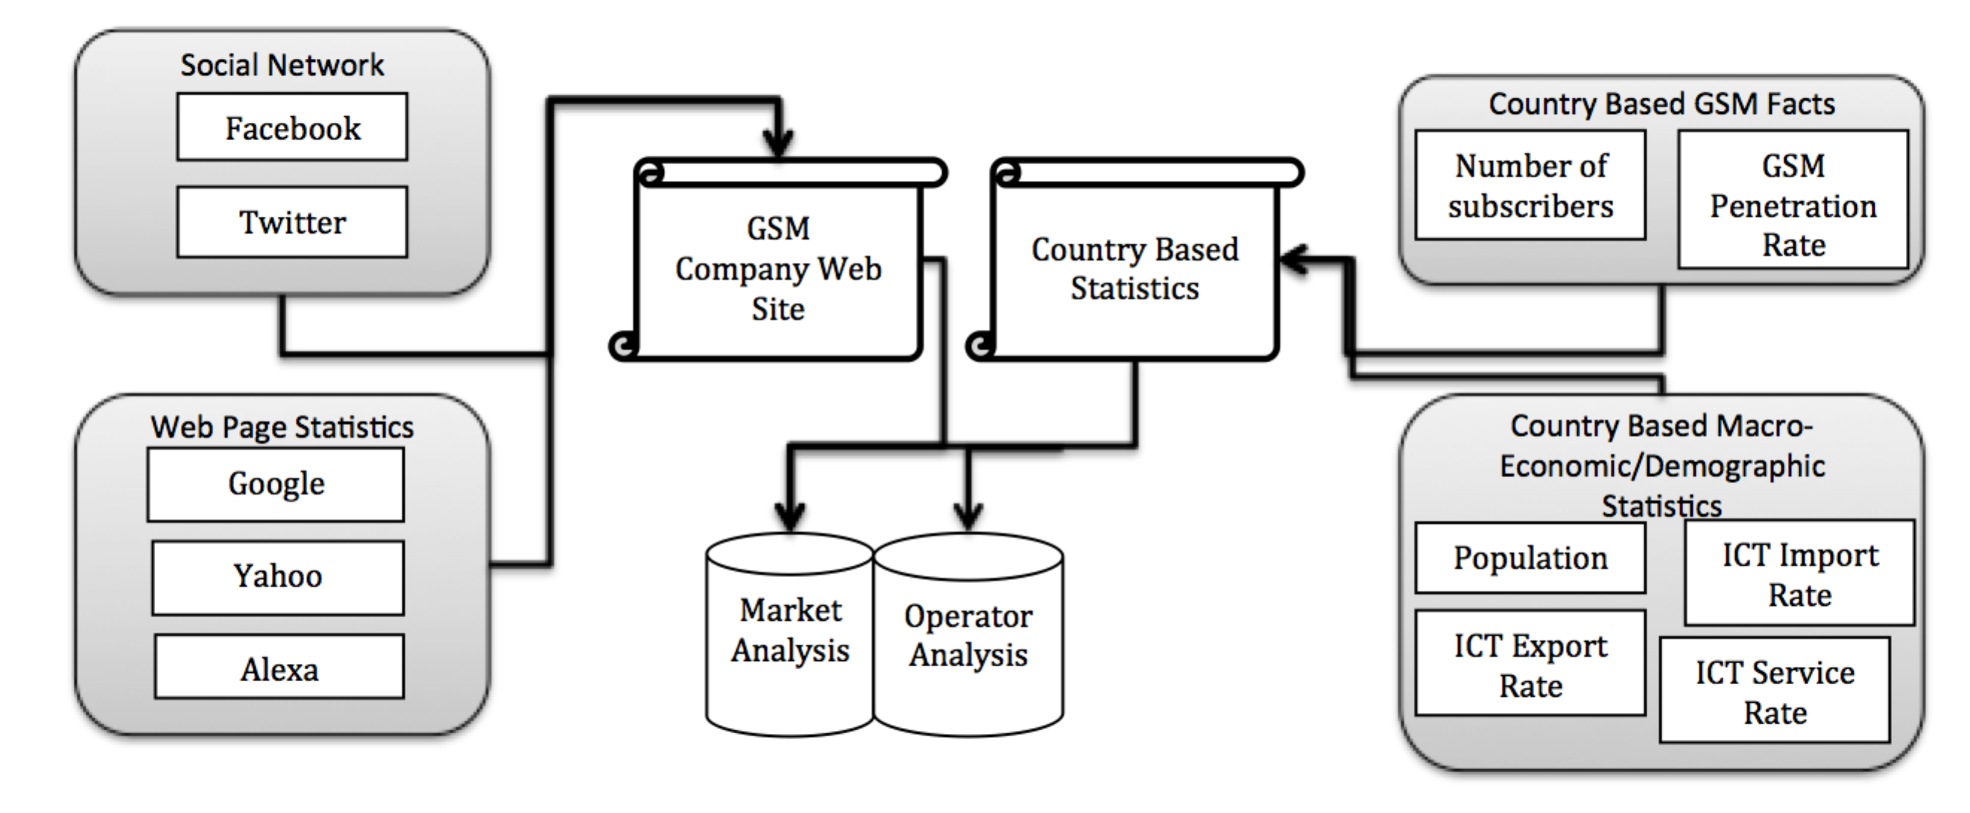
Outline

Slide 4
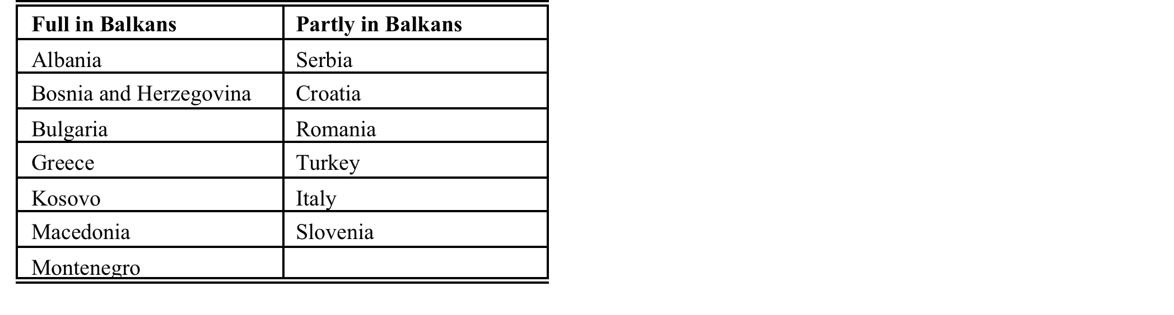
Countries included into the study

Slide 5
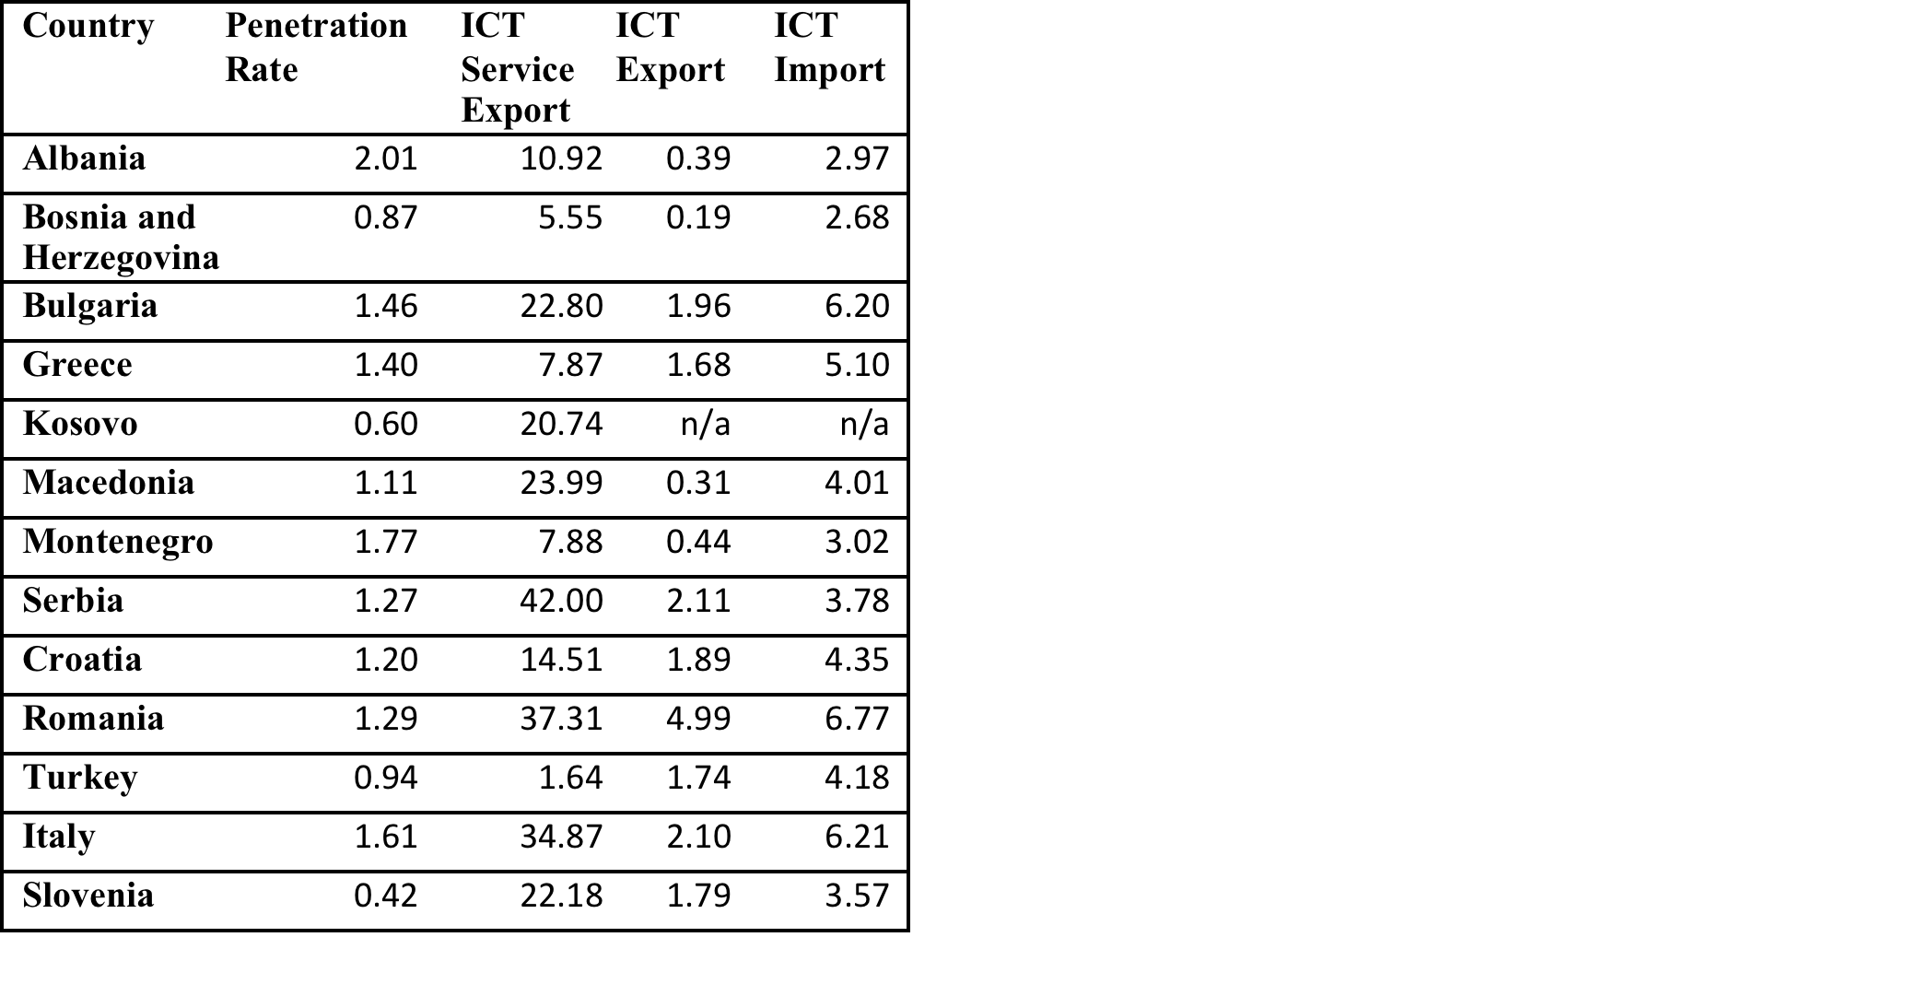
Macroeconomic Facts

Slide 6
ICT by Countries

Slide 8
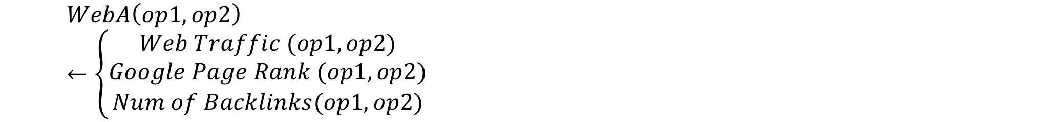
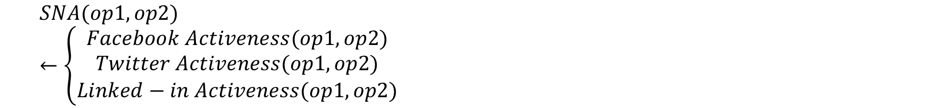
Calculation of digital stats

Slide 9
Normalization
Min – Max Normalization
Internet Activeness of Operator

Slide 11
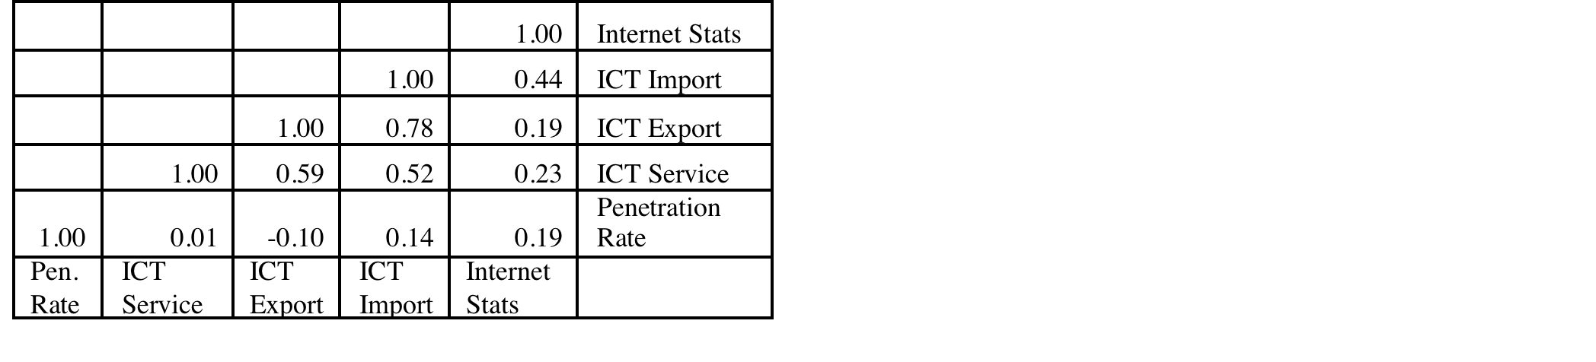
Correlation
Pearson’s r
Correlation Matrix

Slide 12
Correlation

Slide 13
Thank you
You can find the slides and data set from:
http://www.SadiEvrenSEKER.com
Sadi Evren SEKER

